Slide 1
Informational Essay
Week 0f 3/22-3/26 & 4/6-4/10

Slide 2
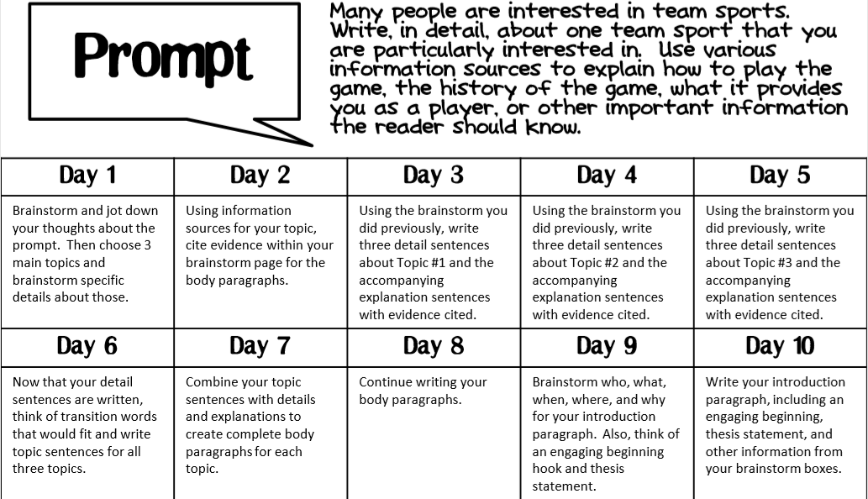

Slide 3
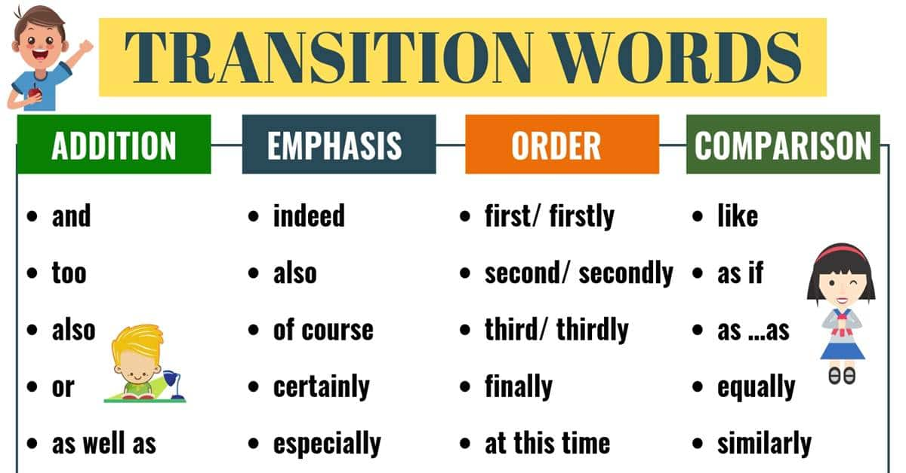
Monday
You will be thinking of transition words to start your topic sentences. Once you have brainstormed you can write your topic sentence introducing each body paragraph
Some examples

Slide 4
Tuesday and Wednesday
It is finally time to write full paragraphs!!
Combine your topic sentences with your detail and example sentences.
Make sure you are using correct capitalization, punctuation, that your words make sense, word spaces, all that good stuff you know :)

Slide 5
Thursday Part 1
Watch this video to better understand what a thesis statement
(your thesis statement should be the last sentence in your introduction paragraph)
https://www.youtube.com/watch?v=mBZKFyykOyM

Slide 6
Thursday Part 2
We have arrived to the introduction paragraph (Yay! No more body paragraphs!!)
This is where you will letting the reader know what the essay is about
Think about a good hook to get the reader excited about reading the next 5 paragraphs! (you could use an interesting fact or a question)
Brainstorm about how you will PREVIEW the information that you will be writing about ( let them know what each body paragraph is about-but don’t give away all your details or examples)

Slide 7
Friday- You’ve reached the halfway point of this essay!
Today you will write the introduction paragraph using your brainstorming from yesterday
Use correct capitalization and punctuation!!

Slide 8
Happy Spring Break!!

Slide 9
Information Essay
Week of 4/6-4/10

Slide 10
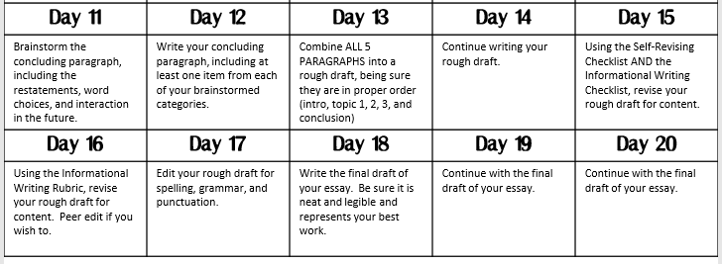

Slide 11
Monday (Hope you had a great Spring Break!)
You are brainstorming your Conclusion paragraph
You are summarizing what you have already written
You should also be talking about if this information is helpful for you or anyone else
(have you learned anything new about the sport? Do you like it more than you did? Do you like it less? Should the reader go find out more interesting information? Or is it dull as dirt and they should avoid it at all costs?-this is your chance to share your opinion)

Slide 12
Tuesday
Use your brainstorming from yesterday to create your conclusion paragraph
Write complete sentences

Slide 13
Wednesday/Thursday
The time has come!!!!!!!!
You are going to start your rough draft!!!
Begin writing all 5 paragraphs in order

Slide 14
Friday
Use the rubric/checklist to edit your work (ARMS and CUPS time!!!!)
Yes, you SHOULD use a pen for this part
1 more week to go till you have a finished 5 paragraph essay :)

Slide 15
Stay tuned for the next powerpoint...

