Slide 1
Informational Essay
Monday

Slide 2
Directions
Over the next month we will be writing a 5 paragraph essay. We will be doing a little everyday adn using graphic organizers that are similar to what we have been using all year. I am putting the pacing guide up for the next 2 weeks on the next slide.
(You will be writing the Final Draft on google docs and sharing it with me)

Slide 3
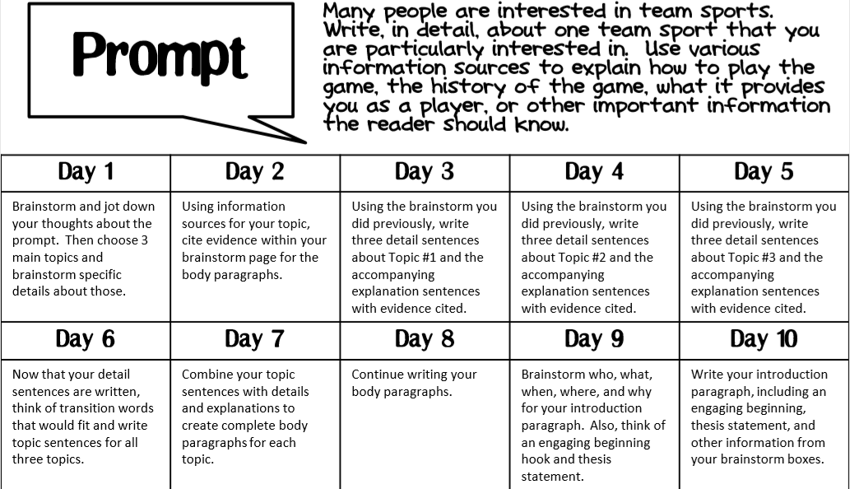

Slide 4
Day 1
Today you need to pick a sport that you either know a lot about or want to know more about. You need to come up with 3 main topics: these will be what you preview in you introductory paragraph and what will be what each of your 3 body paragraphs will be about.
Example: PIng Pong Topic 3:
Topic 1: -Famous ping pong players
-History of ping pong
Topic 2:
-Rules of ping pong

Slide 5
Day 1 Continued
Once you have come up with your 3 topics brainstorm and research 3 to 4 bullet points about each topic (remember if you get information from a book or website you must write down the author/website where the information came from)

