Slide 1
Informational Essay
Week of 4/13-4/17

Slide 2
You Made It! This is the last week to work on this essay :)
Your essay will be due either by sharing it on google docs OR scanning your final draft and emailing me by Friday 4/17/2020
Your rough draft should need just a little editing and then spend the rest of the week typing your final copy
*If you share your typed version on google docs by Wednesday at 12:00 pm I can look over it and give you comments to help you get a higher grade ( I will also give extra credit if you send it to me by Wednesday)

Slide 3
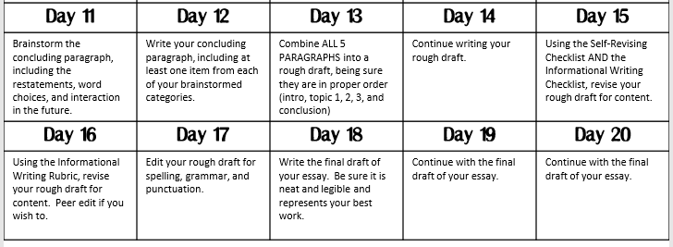
Days 16-20 Monday-Friday 4/13-4/17

Slide 4
You’re Done! Congratulations on writing a 5 paragraph essay!!

