Slide 1
Georgia as a colony
SS8H2 Analyze the colonial period of Georgia’s history.

Slide 2
SS8H2 Analyze the colonial period of Georgia’s history.
a. Explain the importance of the Charter of 1732, including the reasons for settlement (philanthropy, economics, and defense).
b. Analyze the relationship between James Oglethorpe, Tomochichi, and Mary Musgrove in establishing the city of Savannah at Yamacraw Bluff.
c. Evaluate the role of diverse groups (Jews, Salzburgers, Highland Scots, and Malcontents) in settling Georgia during the Trustee Period.
d. Explain the transition of Georgia into a royal colony with regard to land ownership, slavery, alcohol, and government.
e. Give examples of the kinds of goods and services produced and traded in colonial Georgia

Slide 3
SS8H2 Analyze the colonial period of Georgia’s history.
a. Explain the importance of the Charter of 1732, including the reasons for settlement (philanthropy, economics, and defense).

Slide 4
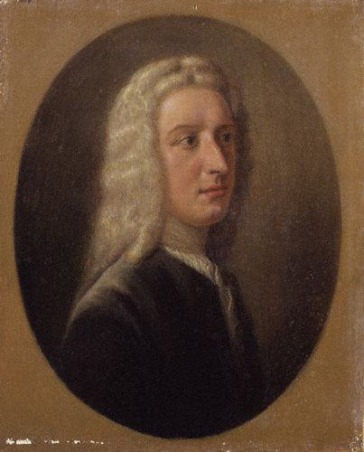
James Oglethorpe
James Oglethorpe was a wealthy, well-educated member of England’s Parliament.
Was upset with the harsh conditions of the average English citizen, especially those in debt
Believed all people were good, it was society that corrupted them
Oglethorpe worked to improve the quality of life for these citizens.

Slide 5
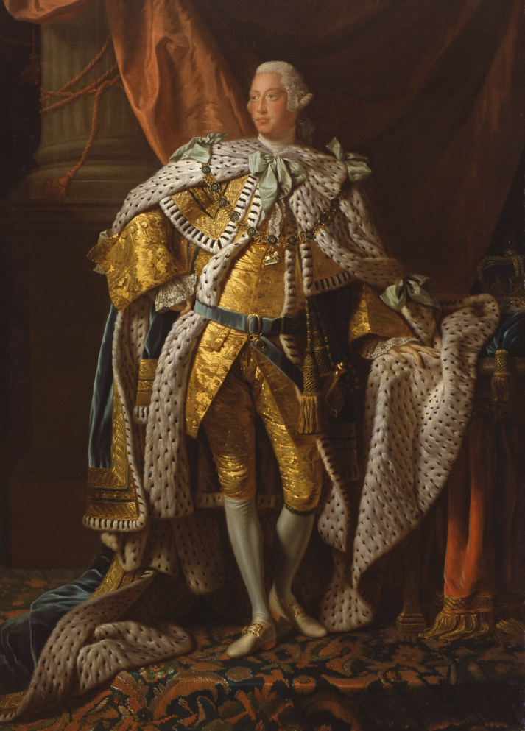
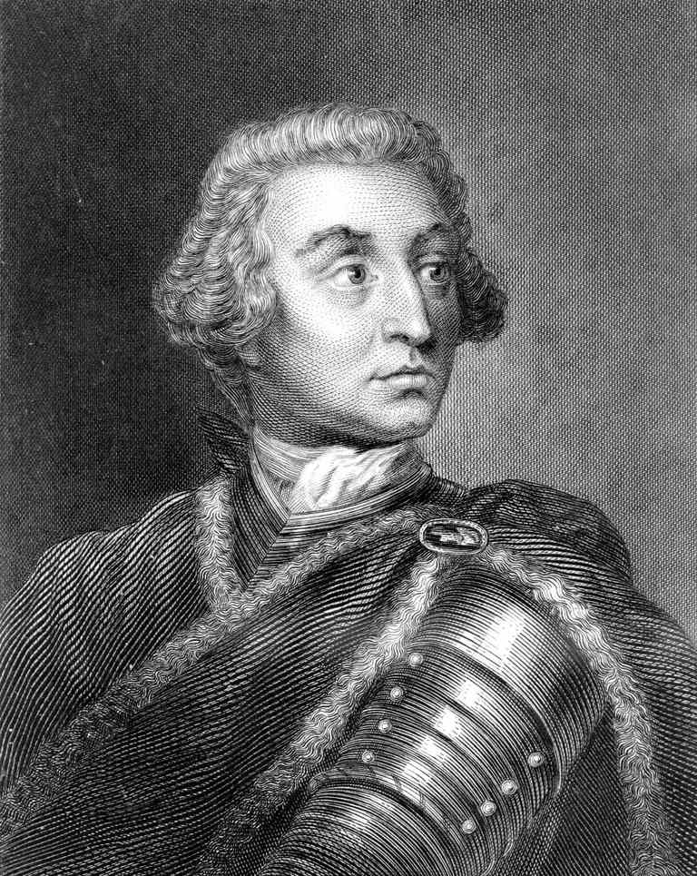
James Oglethorpe
In 1720 he started talking about a colony for England’s poor & unemployed
In 1730 he asked King George II for a charter of land
In 1732 King George gave him the charter for the colony of Georgia & named him as 1 of the 21 trustees

Slide 6
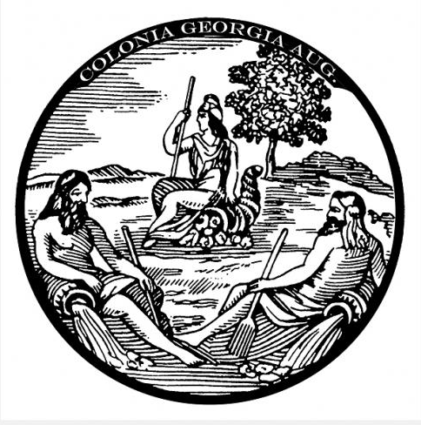
Trustees
Group of 21 Englishmen responsible for establishing and managing the new colony of Georgia
(Think board of directors)

Slide 7
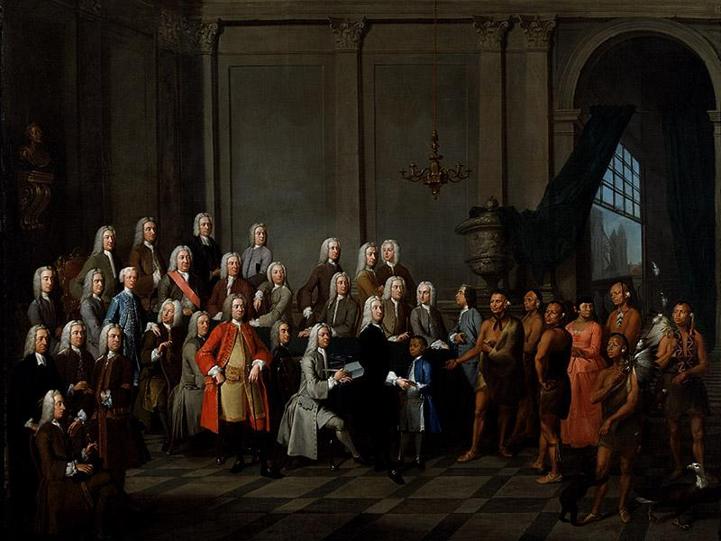

Slide 8
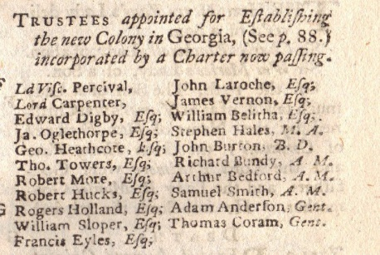

Slide 9
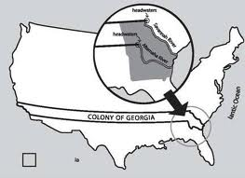

Slide 10
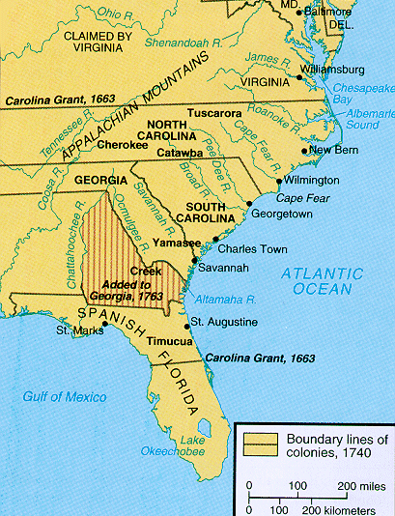
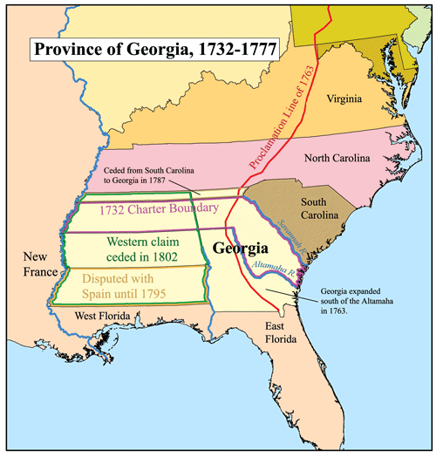

Slide 11
Charter of 1732
The charter of 1732 outlined the 3 reasons for settling Georgia
Philanthropy (Charity)
50 acres of land given freely (500 if you paid your own passage), and 1 year’s supply of food, seed and agricultural supplies
Economics
Mercantilism- specifically W.R.I.S.T. crops
Wine, Rice, Indigo, Silk, and Tobacco
Defense
Georgia was created as a buffer colony to protect South Carolina (very profitable colony) from Spanish Florida

Slide 12
Charter of 1732 (Continued)
Trustees couldn’t:
Own land, hold office or be paid (for being a Trustee)
Requirements:
Colonists had to defend the colony
Things banned:
Selling/ buying land
Rum (hard alcohol) & Liquor dealers
Slavery
Catholics
Lawyers (according to some historians)

Slide 13
SS8H2 Analyze the colonial period of Georgia’s history.
b. Analyze the relationship between James Oglethorpe, Tomochichi, and Mary Musgrove in establishing the city of Savannah at Yamacraw Bluff.

Slide 14
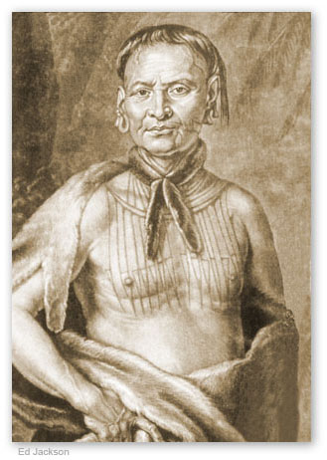
Tomochichi
Chief of the Yamacraw Indians
Created from Creek & Yamasee Indians in 1728
Allowed Oglethorpe to settle on Yamacraw Bluff (future home of Savannah)
Helped advise him on Indian affairs & relations with the Spanish
Developed a strong friendship with Oglethorpe the rest of his life

Slide 15
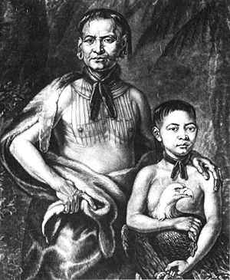
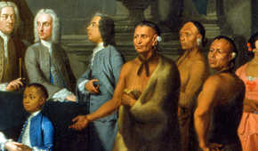

Slide 16
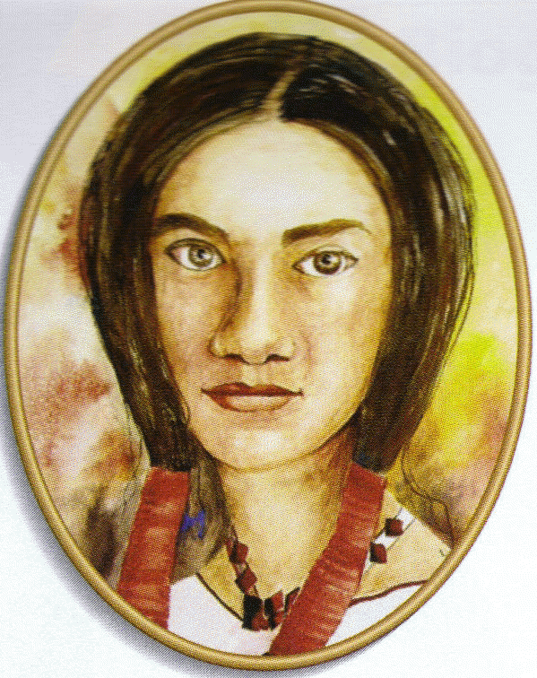
Mary Musgrove
Half Creek/ half English
Could speak both languages & understood both cultures
Was KEY in Georgia’s success
She acted as a negotiator, mediator and interpreter for Oglethorpe from 1733-1743
Taught Oglethorpe:
How to trade fairly
Assisted them in opening several trading posts

Slide 17
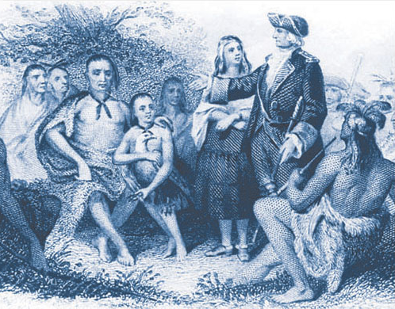

Slide 18
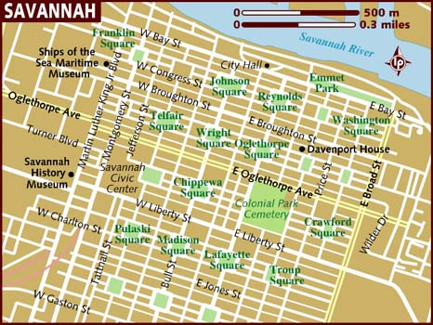
Savannah
The first settlement established in Georgia in 1733
Savannah was the first pre-planned city
Designed by Oglethorpe
Each neighborhood, square, and garden lot was of equal size.
This design allowed for fair land distribution

Slide 19
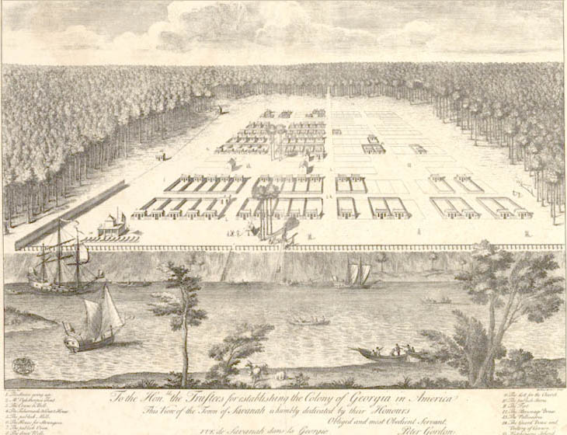

Slide 20
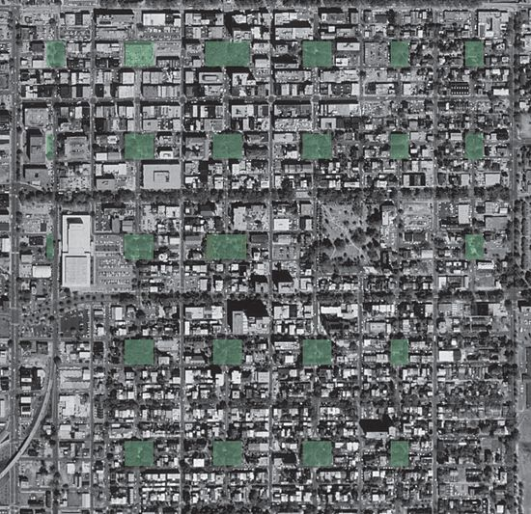

Slide 21
SS8H2 Analyze the colonial period of Georgia’s history.
c. Evaluate the role of diverse groups (Jews, Salzburgers, Highland Scots, and Malcontents) in settling Georgia during the Trustee Period.

Slide 22
Jews
42 Jews arrived in Georgia 5 months after Oglethorpe and his group landed at Yamacraw Bluff
Originally banned in the 1732 Charter Oglethorpe made an exception because one of the Jews was a doctor; Dr Samuel Nunes.
The colony lost 20 people including it’s only doctor to yellow fever

Slide 23
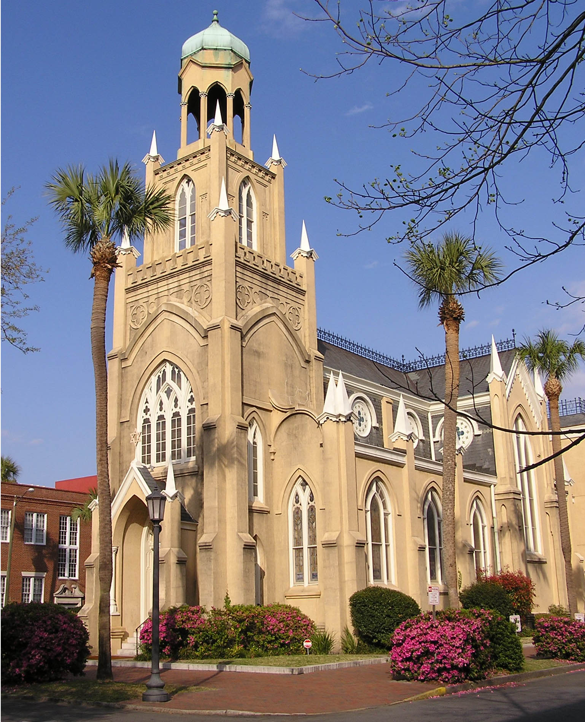
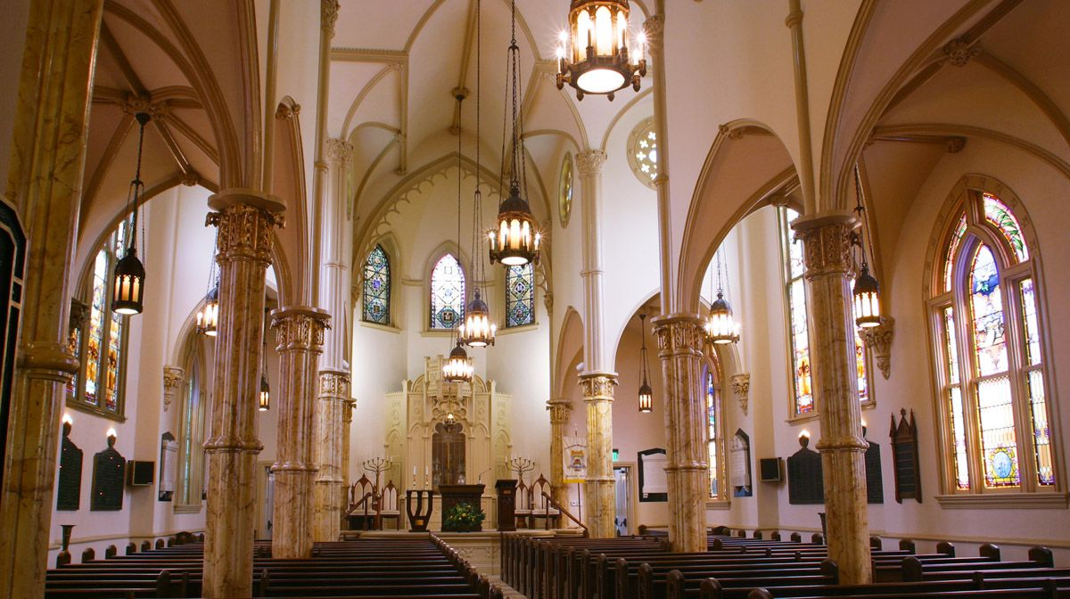

Slide 24
Salzburgers
German-speaking protestant refugees from present-day Austria.
Expelled by a Catholic monarch & allowed to settle by King George II, a German Protestant
Would eventually establish New Ebenezer
Only group to have success with silk
The Salzburgers were against slavery and remained loyal to the trustees

Slide 25
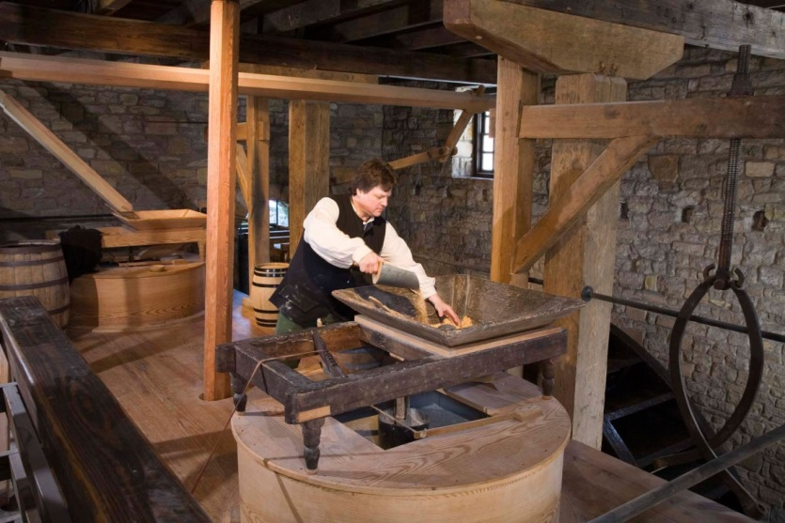
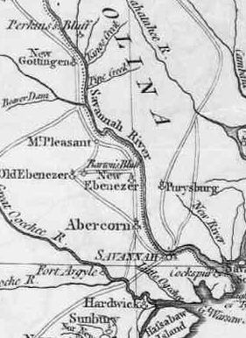
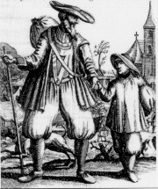
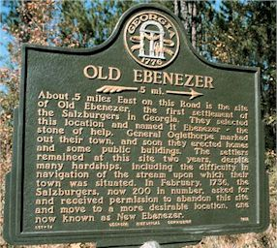

Slide 26
Highland Scots
Oglethorpe brought the Highland Scots to Georgia because of their reputation as the best soldiers in the world.
Given land near abandoned Fort King George and named their settlement Darien.
Fought in the Battle of Bloody Marsh - pushed the Spanish back into Florida and ended the Spanish threat.
Supported the ban on slavery

Slide 27
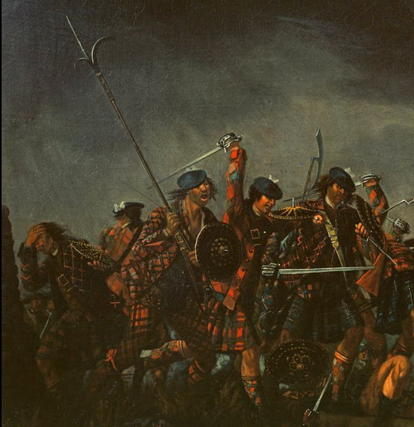
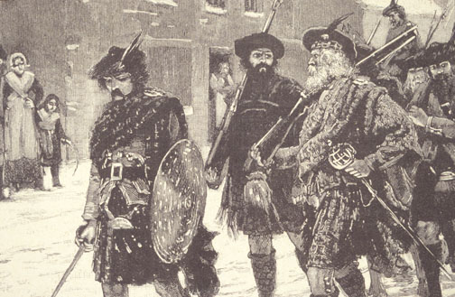

Slide 28
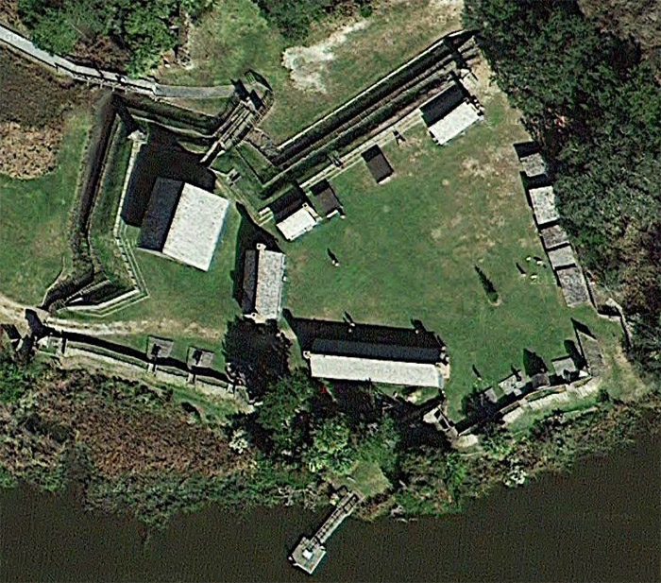
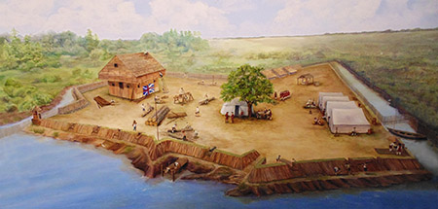
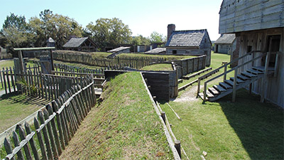
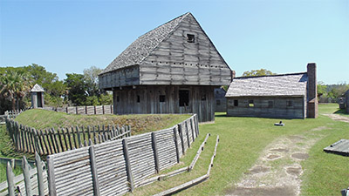

Slide 29
Spanish threat from Florida
Part of the War of Jenkins’ Ear (1739-1748) – Spain v. England
The Spanish attacked St. Simons Island and were defeated by the Oglethorpe’s forces (colonists, Highland Scots, and Indian allies)
Called the Battle of Bloody Marsh
The Spanish eventually retreated to Florida and were no longer a serious threat to Georgia.

Slide 30
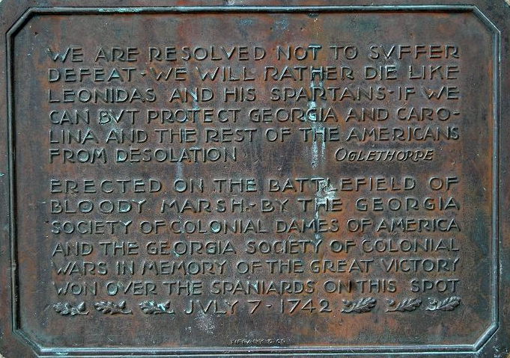
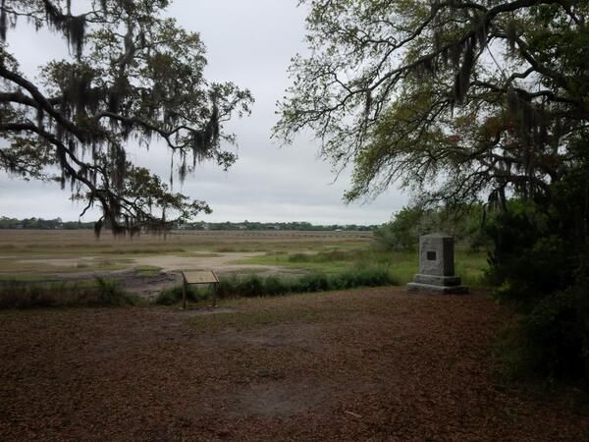

Slide 31
Malcontents
The term used to describe the colonists who were unhappy with the trustees’ regulations
Most of them had paid their own way to Georgia and were not reliant on the trustees for help.
Their main complaints were:
Limits on land ownership
Ban on rum/alcohol
Ban on slavery – the biggest complaint
After 10 years of malcontents’ complaints, the trustees allowed slavery and changed land ownership rules in 1751.

Slide 33
SS8H2 Analyze the colonial period of Georgia’s history.
d. Explain the transition of Georgia into a royal colony with regard to land ownership, slavery, alcohol, and government.
e. Give examples of the kinds of goods and services produced and traded in colonial Georgia

Slide 34
Land Ownership & Alcohol
Rules relaxed for land
Women could own land
Land could be purchased
New settlers claimed the western frontier (“crackers”)
More settlers → Improved Economy → Bigger colony
Alcohol ban no longer enforced by 1742
Repealed in 1749 by Parliament

Slide 35
Slavery
Wanted by colonists to compete with South Carolina
Originally outlawed it was allowed in 1749
From 1750 - 1775, the number of slaves increased from 500 to 18,000
Had no rights at all, would be punished for broken rules
Helped increase agricultural production, especially rice

Slide 36
Government
After the colony was returned to the king he repealed Trustee laws and used Royal Governors to govern Georgia.
John Reynolds (1754-1757)
Henry Ellis (1757-1760)
James Wright (1760-1776)

Slide 37
W.R.I.S.T. Crops
Wine- Not enough quantity; Not a success
Rice- 1st staple crop; Became even more successful when slavery was introduced
Indigo- Successful however indigo production was harmful
Silk- Didn’t return desired profits; Not a success
Tobacco- Became even more successful during royal period

