Slide 1
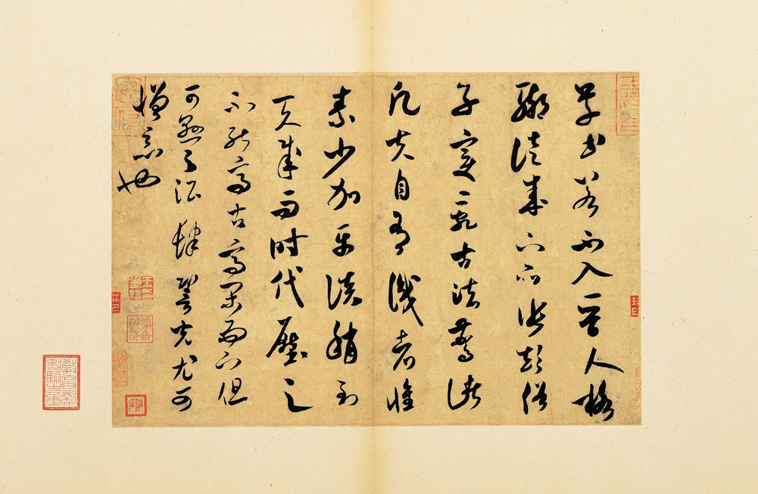
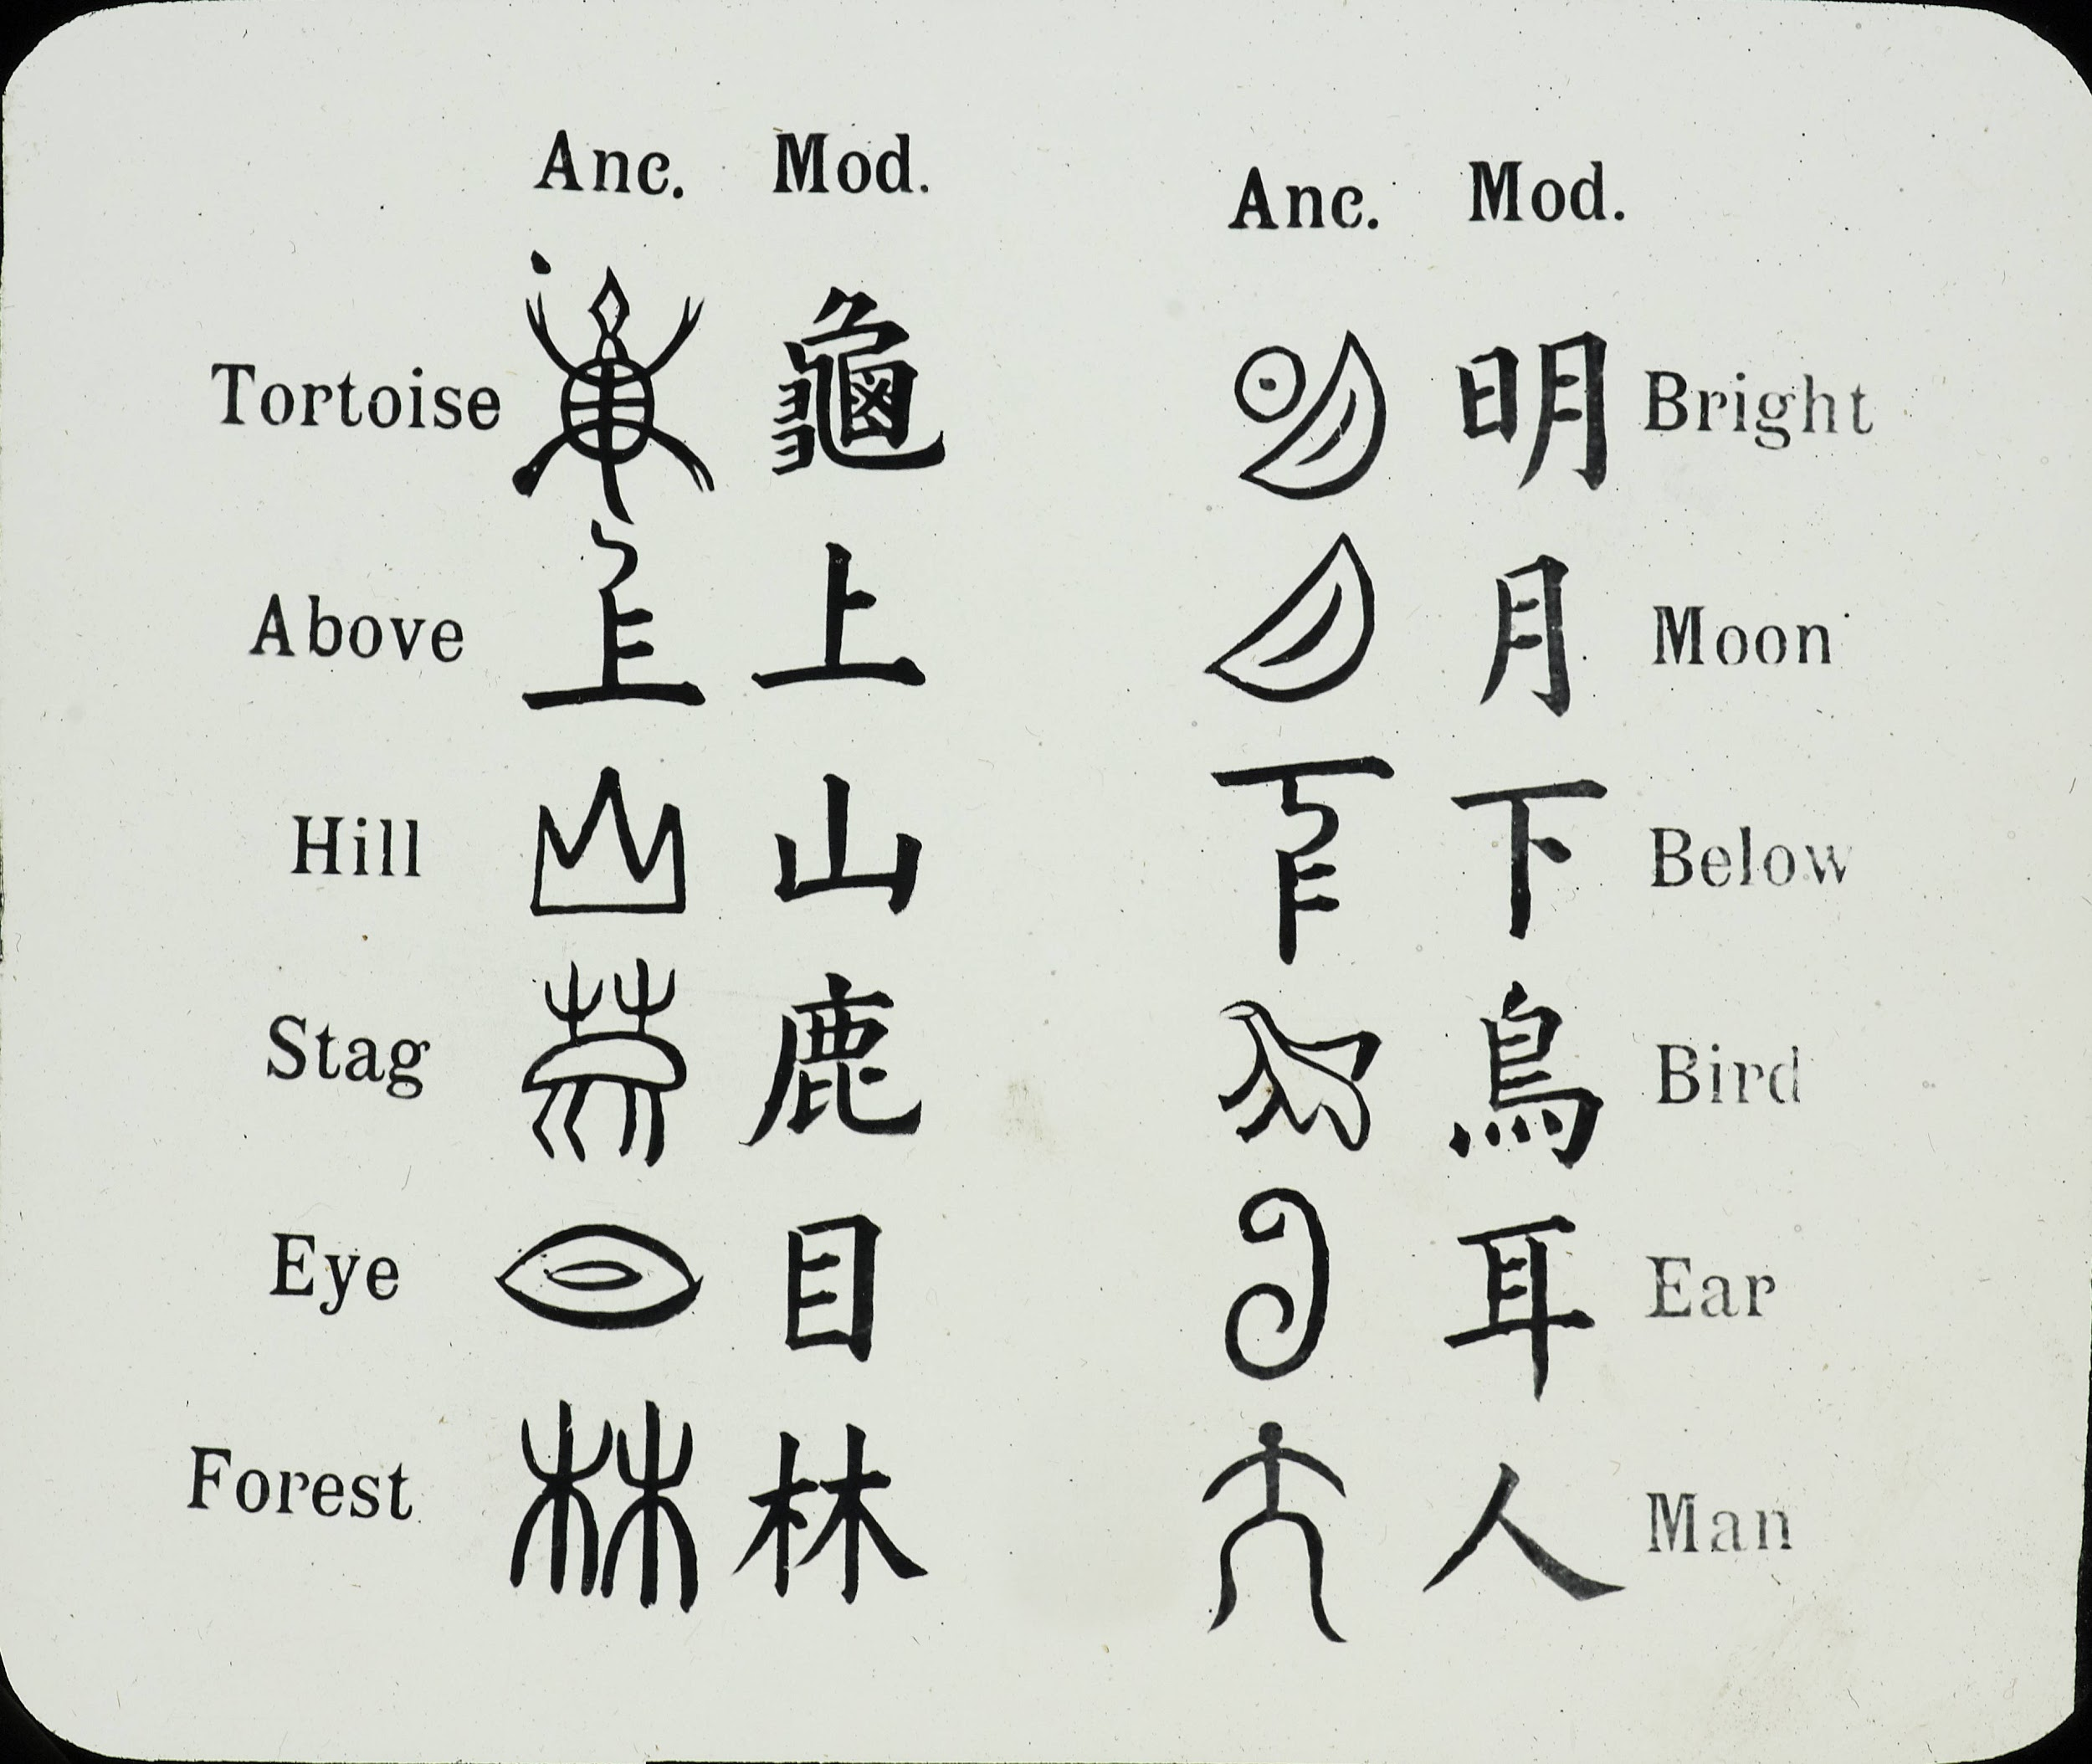
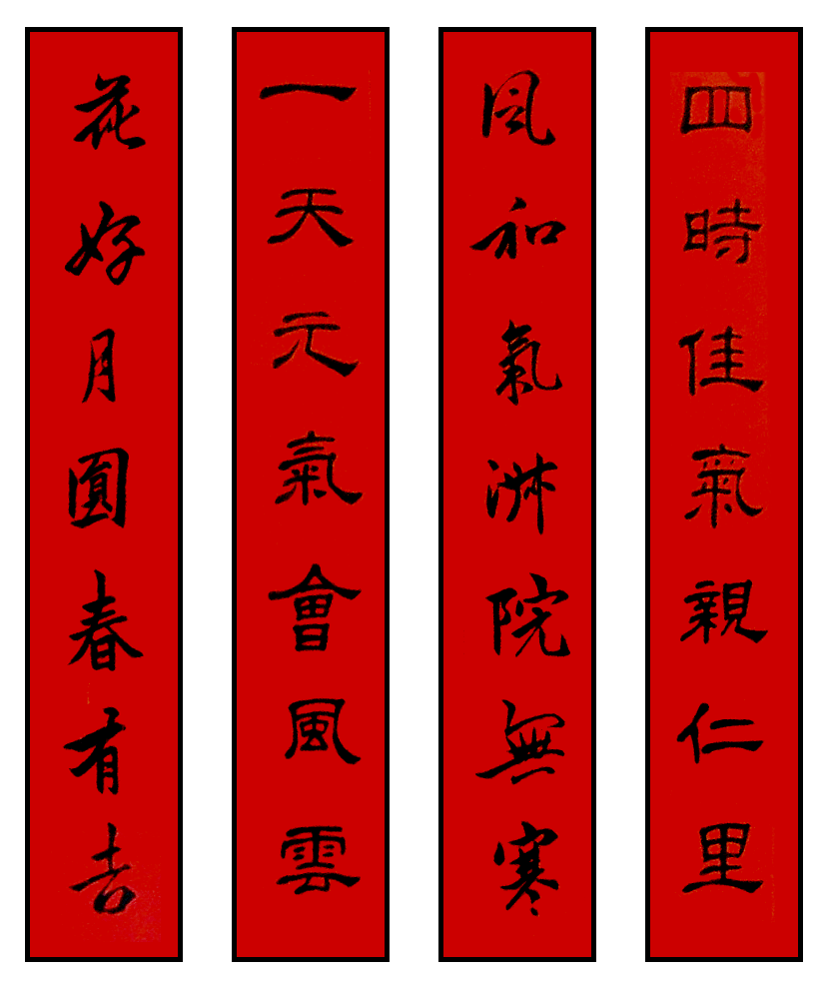
The Chinese Written Language
By: Mrs. Roquemore (高老师)

Slide 2
How to Tell Chinese, Japanese, & Korean Writing Apart
If you're not familiar with Asian writing, the written form of Korean, Japanese, and Chinese may look the same to you.
Sometimes, it’s confusing because Chinese characters are sometimes used in both Korean and Japanese writing.
However, the 3 scripts used for these 3 different languages are quite different.
If you learn to notice special character shapes and text formatting, you should be able to distinguish between Chinese, Japanese, and Korean writing, even if you can't read any of them.

Slide 3
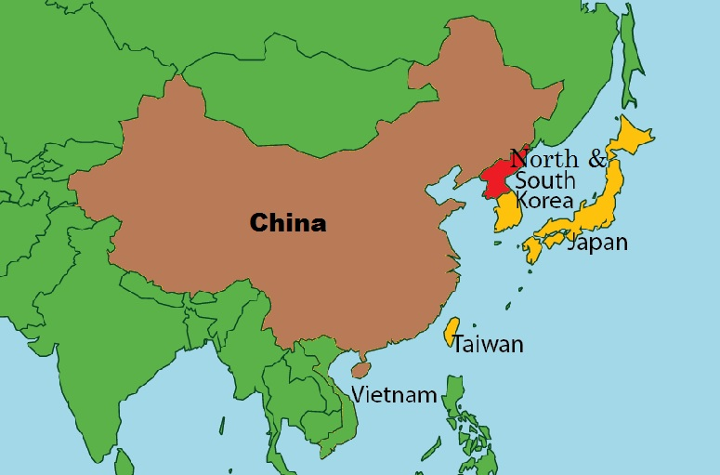
Where Are These 3 Countries in Relation to One Another?

Slide 4
Method 1 - Evaluating Character Shapes
Look for circles and ovals to identify Korean writing. Ovals and circles are fairly common in Korean script but virtually unused in Chinese or Japanese characters. If you see a lot of open ovals and circles, as well as open squares, you can be fairly certain that you are looking at Korean script.
While Japanese has curvy shapes, it doesn't have complete circles within the characters as Korean does.
Korean has an alphabet, just like the English language.

Slide 5
Method 1 - Evaluating Character Shapes
Recognize complex square characters as Chinese characters. Chinese characters may appear in Chinese, Japanese, or Korean (old language). However, if the writing is in nothing but Chinese characters, then what you're looking at is Chinese.
Chinese characters are extremely detailed. Strokes don't cross outside the square perimeter of any character, giving a line of script a consistent, uniform appearance.
In contrast, Japanese has a more open and airy style of script.
While Korean characters are orderly and regimented, they aren't quite as dense or complex as Chinese characters, with a lot more open space.
Tip: Chinese characters aren't common in modern Korean writing. However, if you're looking at an older text, you may see Chinese characters interspersed among Korean script, especially for words of Chinese origin.

Slide 6
Method 1 - Evaluating Character Shapes
Identify Japanese script as light and loose. Loose, curvy lines that aren't constrained to a small box are Japanese hiragana. The characters are extremely simple compared to Korean or Chinese characters, some only requiring a single stroke of the pen to reproduce.
For a quick shortcut, look for the character "の."
Neither Korean nor Chinese have a character that looks anything like "の." It's typically pretty easy to remember and spot.
If you see this character in a passage of writing, it's most likely Japanese writing, even if you notice a few Chinese characters.

Slide 7
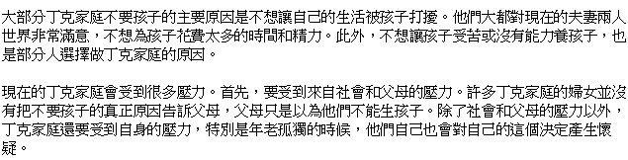
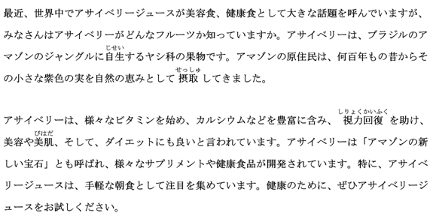
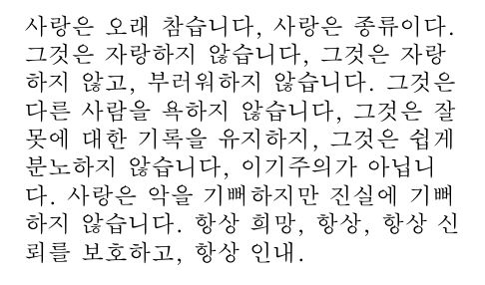
Let’s Test Your Knowledge

Slide 8
Method 2 - Analyzing Text Formatting
Look for spaces between words. Neither Chinese nor Japanese separate individual words with spaces as European languages do. However, Koreans have adopted this convention and put spaces between words.
Even if you can't read the script, you should be able to identify characters blocked together into words.

Slide 9
Method 2 - Analyzing Text Formatting
Identify Western-style punctuation. While Japanese & Chinese have their own punctuation marks, Korean uses the same punctuation marks as European languages. If you see these punctuation marks, you're likely reading Korean.
But as the world becomes more global, you will see European commas, periods, and quotation marks used more often in the Chinese language.

Slide 10
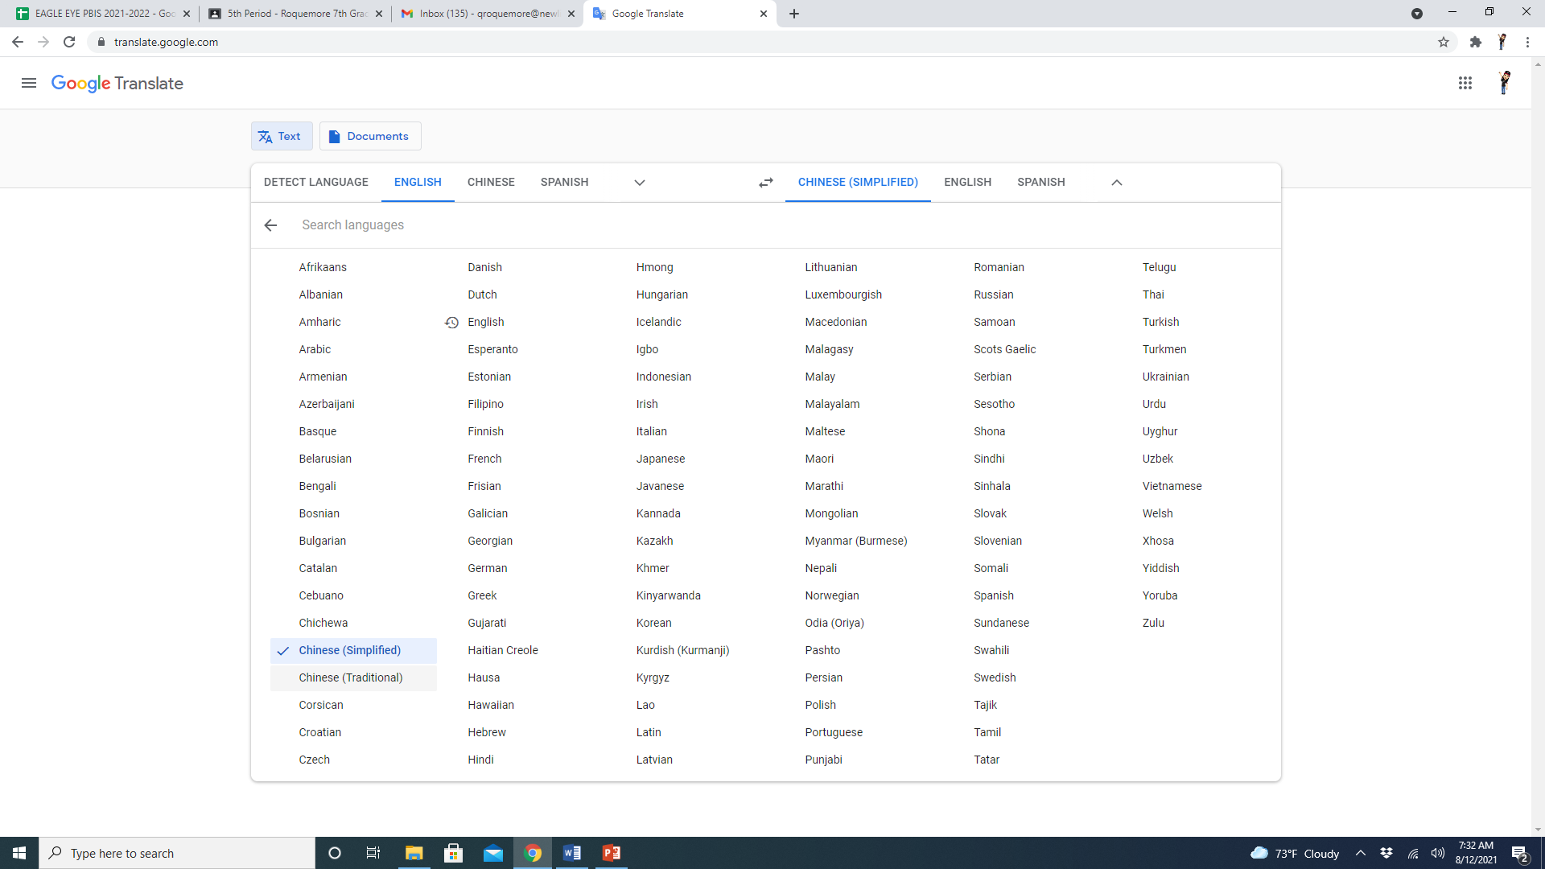

Slide 11
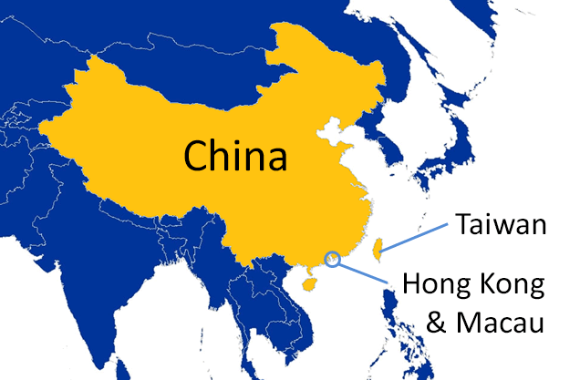
Traditional vs. Simplified Chinese
Why are there two different ways of writing & which one do we learn at New Life?
Traditional
Traditional Chinese is the writing system that has been used by the people of China for thousands of years.
Its characters are considered to be more complex and feature more strokes than the simplified version.
This writing system is official in Hong Kong, Taiwan, and Macau.
Simplified
Simplified Chinese is a less complicated form of Traditional Chinese introduced by the People’s Republic of China on Mainland China between 1949 and 1964.
The majority of rural people in China could not read Traditional Chinese due to its complexity, so the government implemented the simplified system with the hope of improving literacy rates.
The plan seems to have worked. When the simplified writing system began to be taught, China’s literacy rate was around 20%. It’s now estimated to be around 95%.
The process of simplification of Traditional Chinese was achieved by reducing strokes as well as merging characters.
A stroke is a pen motion used to write a character.
The more strokes a character has, the more complex it is.
For example, the character “to hear” 聽 (tīng) is made up with many strokes for such a simple term.
Simplifying it to 听 makes it much easier to remember.

Slide 12
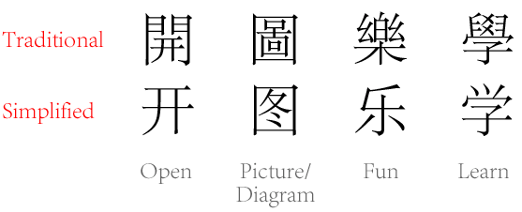
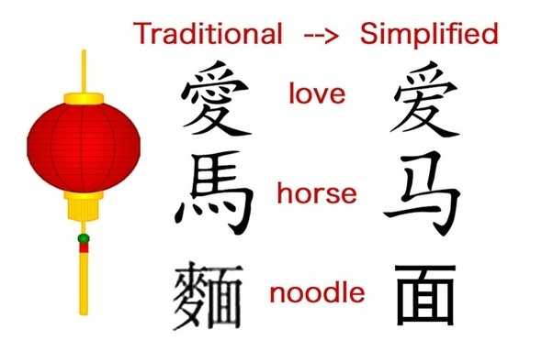
Examples

Slide 13
What is Pīnyīn?
Pīnyīn is the “European” way of writing Chinese characters by using a standard European alphabet.
The arguments for a Simplified Chinese set began in the early 1900s but it wasn’t implemented until the People’s Republic of China (currently China’s Communist government) was formed in 1949.
Interestingly, the eventual goal of character simplification was to completely romanize the Chinese writing system and use a European alphabet (don’t know if this is still the goal).
This is why pīnyīn was invented and promoted around the same time. The goal was to increase literacy, both in the older population, as well as globally.
At New Life Academy of Excellence’s middle school level, we will be focusing on learning/pronouncing new vocabulary through pīnyīn and recognizing/writing simplified Chinese characters.

Slide 14
Restroom
Simplified Characters
Pīnyīn
我 可以 上 厕所 吗
Wǒ kěyǐ shàng cèsuǒ ma?
I/me can get on toilet yes/no
Can I use the toilet/bathroom?

Slide 15
Water
我 可以 喝 水 吗？
Wǒ kěyǐ hē shuǐ ma?
I/me can drink water yes/no
Can I drink water?

Slide 16
Sources
How to Tell Chinese, Japanese, and Korean Writing Apart
https://www.wikihow.com/Tell-Chinese,-Japanese,-and-Korean-Writing-Apart
Traditional vs. Simplified Chinese
https://www.fluentu.com/blog/chinese/2019/05/20/traditional-vs-simplified-chinese/
What is the Difference Between Simplified Chinese and Traditional Chinese?
https://www.pangeanic.com/knowledge_center/what-is-the-difference-between-simplified-chinese-and-traditional-chinese/
The Difference Between Simplified and Traditional Chinese
https://www.globalizationpartners.com/2016/11/09/the-difference-between-traditional-and-simplified-chinese/#:~:text=Some%20examples%20include%3A%20%20%20Character%20%20,Dragon%20%20%20%E9%BE%8D%20%20%20%E9%BE%99%20

