Slide 1
Numbers
In Relation to Dates & Time
By: Mrs. Roquemore (高老师)

Slide 3
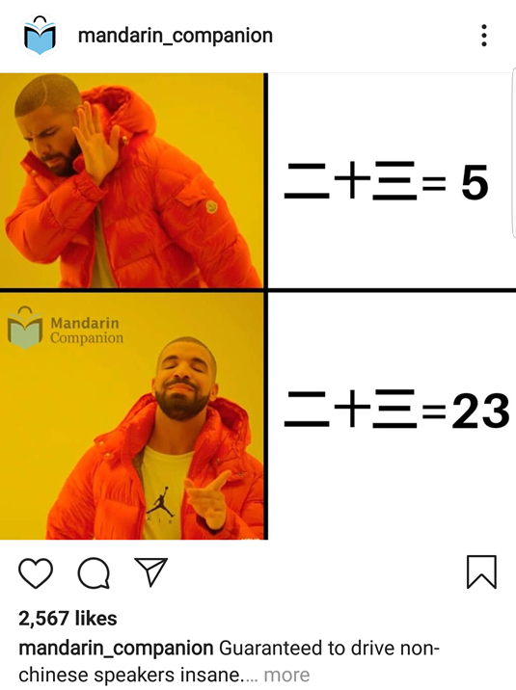
Let’s Review – Basic Numbers 0-99
0 – líng (零 or O)
1 – yī (一)
2 – èr (二)
3 – sān (三)
4 – sì (四)
5 – wǔ (五)
6 – liù (六)
7 – qī (七)
8 – bā (八)
9 – jiǔ (九)
10 – shí (十)
11 – shí yī (十一)
12 – shí èr (十二)
13 – shí sān (十三)
14 – shí sì (十四)
15 – shí wǔ (十五)
16 – shí liù (十六)
17 – shí qī (十七)
18 – shí bā (十八)
19 – shí jiǔ (十九)
20 – èr shí (二十)
21 – èr shí yī (二十一)
22 – èr shí èr (二十二)
23 – èr shí sān (二十三)
24 – èr shí sì (二十四)
25 – èr shí wǔ (二十五)
26 – èr shí liù (二十六)
27 – èr shí qī (二十七)
28 – èr shí bā (二十八)
29 – èr shí jiǔ (二十九)
30 – sān shí (三十)
31 – sān shí yī (三十一)
32 – sān shí èr (三十二)
33 – sān shí sān (三十三)
34 – sān shí sì (三十四)
35 – sān shí wǔ (三十五)
36 – sān shí liù (三十六)
37 – sān shí qī (三十七)
38 – sān shí bā (三十八)
39 – sān shí jiǔ (三十九)
40 – sì shí (四十)
50 – wǔ shí (五十)
60 – liù shí (六十)
70 – qī shí (七十)
80 – bā shí (八十)
90 – jiǔ shí (九十)

Slide 5
The Extra Number for 2 - “liǎng (两)”
There are 2 ways to say "two" in Mandarin Chinese: 二 (èr) or 两 (liǎng).
These characters can sometimes (not always) be used interchangeably so it's important to know when it is appropriate to use which form.
When Counting Items/Objects
两 (liǎng) is used with measure words such as 个 (ge) or 本 (běn). For example:
两个人 (liǎng ge rén) – two people
两本书 (liǎng běn shū) – two books
Note: This is only for the number “two” – not numbers that already start and end with “二 (èr)” such as 22, 52, 102.
Counting Numbers (no items/objects)
二 (èr) is used when counting without measure words. For example:
一, 二, 三 (yī, èr, sān) – one, two, three
十，十一， 十二 (​shí, shí yī, shí èr) – 10, 11, 12
二十，二十二，二十三 (èr shí, èr shí èr, èr shí sān) – 20, 21, 22

Slide 6
Hundreds (100s) & Thousands (1,000s)
Hundreds – bǎi (百)
100 – yī bǎi (一百)
200 – èr bǎi or liǎng bǎi (两百)
500 – wǔ bǎi (五百)
798 – qī bǎi jiǔ shí bā (七百九十八)
Thousands – qiān (千)
1,000 – yī qiān (一千)
2,000 – èr qiān or liǎng qiān (两千)
5,000 – wǔ qiān (三千)
6,345 – liù qiān sān bǎi sì shí wǔ (六千 三百 四十五)
**Note: Some numbers can include both kinds of "two." For instance:
2,202 - liǎng qiān liǎng bǎi líng èr (两千 两百 零二​) ← most common
but you can also just say: “èr qiān èr bǎi líng èr”
Counting Measure Word Numbers
Some numbers are also used as measure words.
For example, 百 (bǎi) – 100 and 千 (qiān) – 1000, are measure word numbers.
In those cases, numbers like 200 and 2,000 can take the 两 (liǎng) form.

Slide 7
Dates

Slide 8
Days of the Week
Week – xīng qí (星期)
To say the days of the week, you use the word “xīng qí” followed by the number day of the week.
**Monday is the first day of the week.
**The only one that doesn’t follow this pattern is Sunday.
Monday – xīng qí yī (星期一)
Tuesday – xīng qí èr (星期二)
Wednesday – xīng qí sān (星期三)
Thursday – xīng qí sì (星期四)
Friday – xīng qí wǔ (星期五)
Saturday – xīng qí liù (星期六)
Sunday – xīng qí rì (星期日) or
xīng qí tiān (星期天)

Slide 9
Months of the Year
January – yī yuè (一月)
February – èr yuè (二月)
March – sān yuè (三月)
April – sì yuè (四月)
May – wǔ yuè (五月)
June – liù yuè (六月)
July – qī yuè (七月)
August – bā yuè (八月)
September – jiǔ yuè (九月)
October – shí yuè (十月)
November – shí yī yuè (十一月)
December – shí èr yuè (十二月)
Month – yuè (月)
(this word also means “moon”)
To say the months of the year, you just count the months and add the number before the word “yuè”.

Slide 10
Pikachu 在哪里？
1.
四月
2.
十月
7.
八月
8.
十二月
3.
一月
4.
七月
9.
二月
10.
六月
5.
三月
6.
十一月
11.
五月
12.
九月

Slide 11
Day
Day – rì (日)
(Can also mean “date” and “sun”.)
This is the same word that’s in “xīng qí rì (Sunday)”.
January 1 - yī yuè yī rì (一月一日)
May 22 – wǔ yuè èr shí èr rì (五月二十二日)
November 11 – shí yī yuè shí yī rì (十一月十一日)
June 4 – liù yuè sì rì (六月四日)
October 6 - shí yuè liù rì (十月六日)

Slide 12
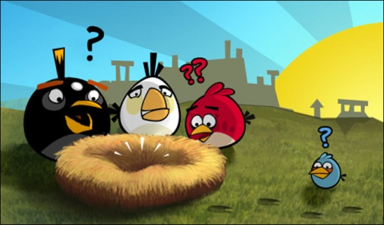
Angry Bird 在哪里？
Jan 1st
Mar 15th
Jun 17th
Jul 30th
Sep 24th
Dec 25th
Apr 2nd
Aug 9th
Feb 14th
May 31st
Oct 10th
Nov 11th

Slide 13
Year
Year – nián(年)
To say the year, you break up each number into single digits.
Example: 2020 in English is “twenty-twenty” or “two thousand twenty”. In Chinese, it’s “two zero two zero”
1776 – yī qī qī liù nián (一七七六年)
1865 – yī bā liù wǔ nián (一八六五年)
1987 – yī jiǔ bā qī nián (一九八七年)
2006 – èr líng líng liù nián (二OO六年)
2019 – èr líng yī jiǔ nián (二O一九年)

Slide 14
Format
In English, the format/order of dates goes:
Day of the Week + Month + Day + Year
Example: Wednesday, November 11, 2020
In Chinese, the format is usually written in a different order:
Year + Month + Day + Day of the Week
Example: èr líng èr líng nián, shí yī yuè, shí yī rì, xīng qí sān
二O二O年,十一月 十一日, 星期三
You could also write it in this format: 2020年, 11月11日, 星期三
Chinese numbers like 一, 二, 三 is equivalent to in English how we write “one, two, three” – but they use 1, 2, 3 as well.

Slide 15
Dates Review
Tuesday
November 17
November 17, 2020
Tuesday, November 17, 2020
Thursday
February 29
February 29, 2010
Thursday, February 29, 2010
xīng qí èr (星期二)
shí yī yuè shí qī rì (十一月十七日)
èr líng èr líng nián, shí yī yuè shí qī rì (二O二O年,十一月十七日)
èr líng èr líng nián, shí yī yuè shí qī rì, xīng qí èr
(二O二O年,十一月十七日,星期二)
xīng qí sì(星期四)
èr yuè èr shí jiǔ rì (二月二十九日)
èr líng yī líng nián, èr yuè èr shí jiǔ rì (二O一O年,二月二十九日)
èr líng èr líng nián, èr yuè èr shí jiǔ rì, xīng qí sì
(二O一O年,二月二十九日,星期四)

Slide 16
Dates Review 2
Friday, January 1, 2021
Sunday, September 10, 1996
Monday, March 14, 1987
Saturday, October 3, 2001
èr líng èr yī nián, yī yuè yī rì, xīng qí wǔ
(二O二一年,一月一日, 星期五)
yī jiǔ jiǔ liù nián, jiǔ yuè shí rì, xīng qí rì/tiān
(一九九六年,九月十日, 星期日/ 天)
yī jiǔ bā qī nián, sān yuè shí sì rì, xīng qí yī
(一九八七年, 三月十四日, 星期一)
èr líng líng yī nián, shí yuè sān rì, xīng qí liù
(二OO一年,十月三日, 星期六)

Slide 17
Time

Slide 18
Time
hour – diǎn (点)
o’clock – zhōng (钟)
half – bàn (半) – used only for :30
minute – fēn (分)
right now – xiàn zài (现在)
what time is it? - jǐ diǎn (几点)
** Note: 2:00 can be both 两点钟 “liǎng diǎn zhōng” and 二点钟 “èr diǎn zhōng”

Slide 19
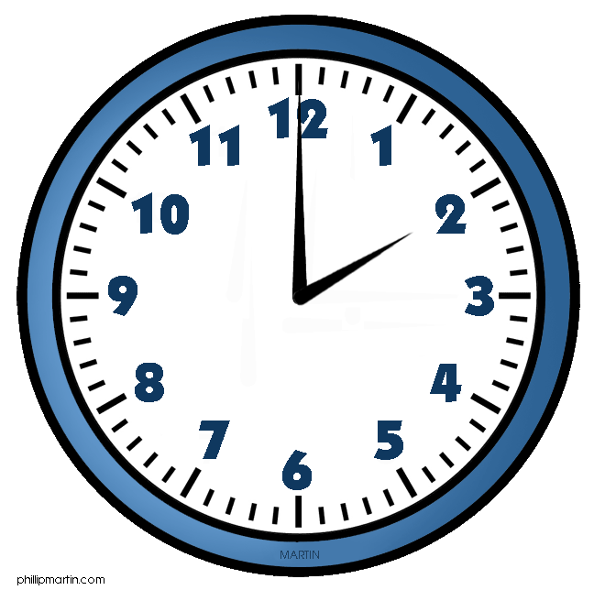
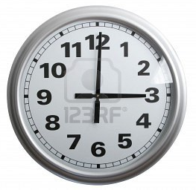
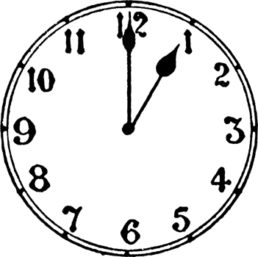
一点 (钟)
两点 (钟)
三点 (钟)
yī diǎn (zhōng)
liǎng diǎn (zhōng)
sān diǎn (zhōng)

Slide 20
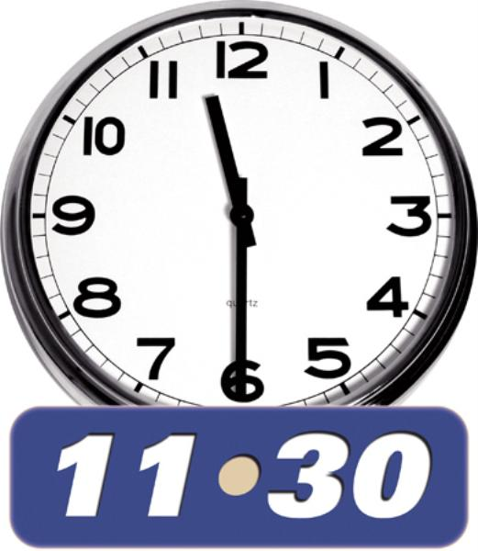
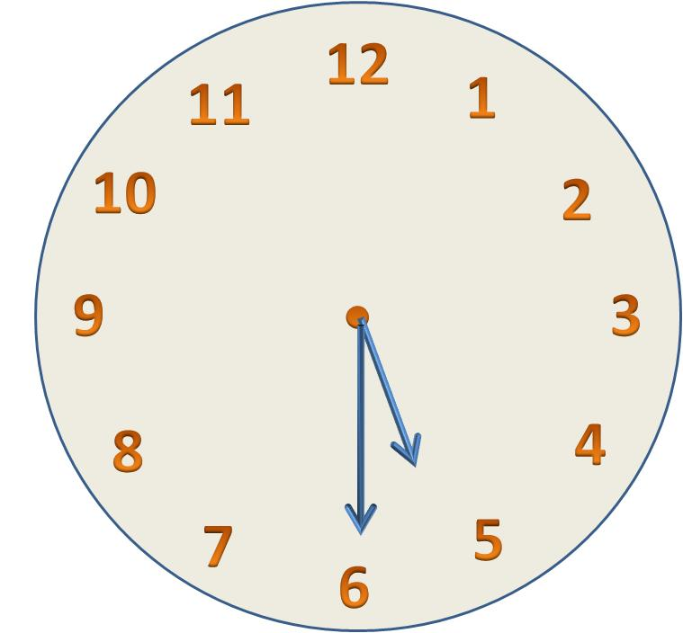
五点半
两点半
十一 点半
wǔ diǎn bàn
liǎng diǎn bàn
shí yī diǎn bàn

Slide 21
Structure for All other Times
Hour 点 (diǎn) Minute 分 (fēn)
____点 ____分
1:15 一点十五分 (Yī diǎn shíwǔ fēn)
4:45 四点四十五分 (Sì diǎn sìshíwǔ fēn)
8:27 八点二十七分 (Bā diǎn èrshíqī fēn)
6:13 六点十三分 (Liù diǎn shísān fēn)
9:02 九点〇二分 (Jiǔ diǎn líng èr fēn)

Slide 22
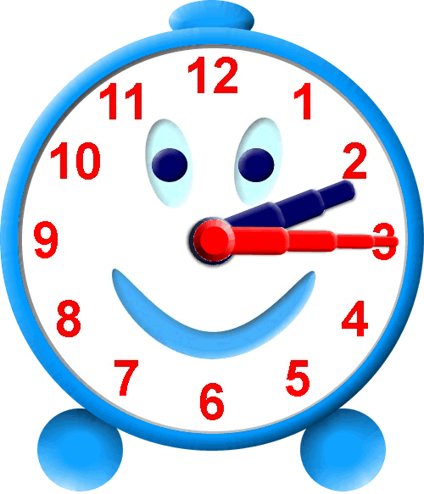
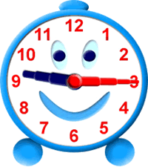
九点十五分
两点十五分
jiǔ diǎn shí wǔ fēn
liǎng diǎn shí wǔ fēn

Slide 23
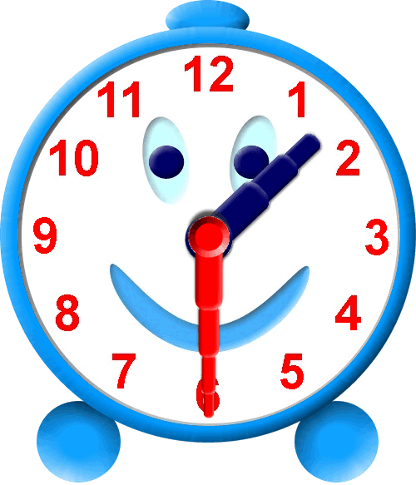
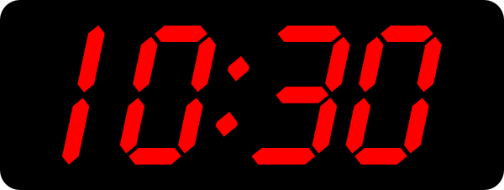
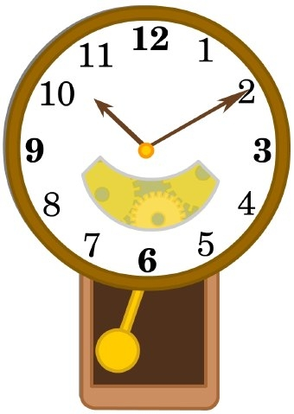
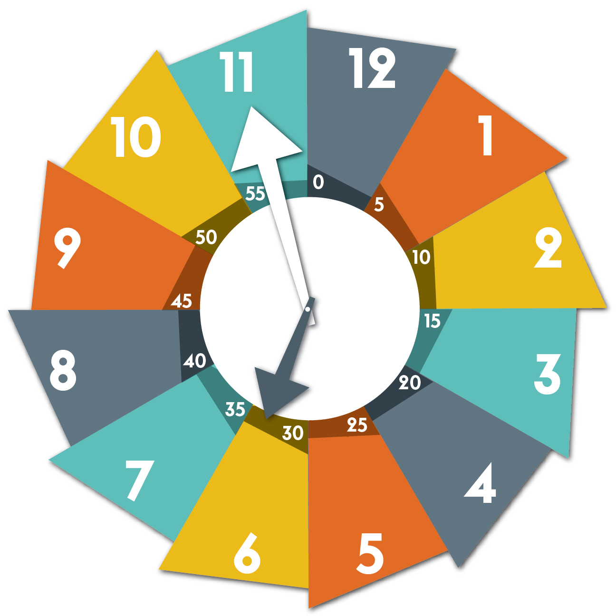
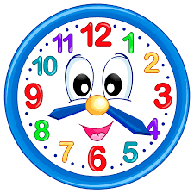
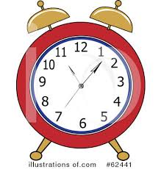
Practice!
1.
2.
3.
4.
5.
6.

Slide 24
How to Differentiate Between AM/PM in Chinese
In Chinese, we do not use AM/PM to split the day in half.
Instead, we differentiate times by indicating the different parts of the day.
Morning – zǎo shàng (5:00 AM-11:00 AM)
Afternoon/Noon – xià wǔ (12:00 PM-5:00 PM)
Evening/Night – wǎn shàng (6:00 PM-11:00 PM)
Midnight/Middle of the Night - bàn yè (12:00 AM-4:00 AM)
We add these words before the time (not after like AM/PM).

Slide 25
Practice
1:15 AM bàn yè, yī diǎn shíwǔ fēn
4:45 PM xià wǔ, sì diǎn sìshíwǔ fēn
8:27 AM zǎo shàng, bā diǎn èrshíqī fēn
6:13 PM wǎn shàng, liù diǎn shísān fēn
9:02 AM zǎo shàng, jiǔ diǎn líng èr fēn

