Slide 1
Yán Sè
(Colors)
By: Mrs. Roquemore (高老师)

Slide 2
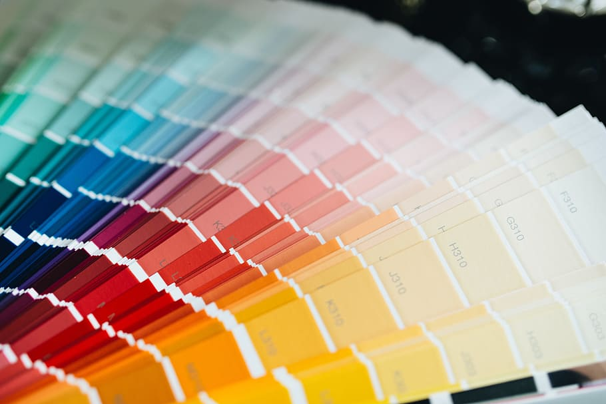
Color
yán sè (颜色) = color
sè = 色 = color

Slide 3
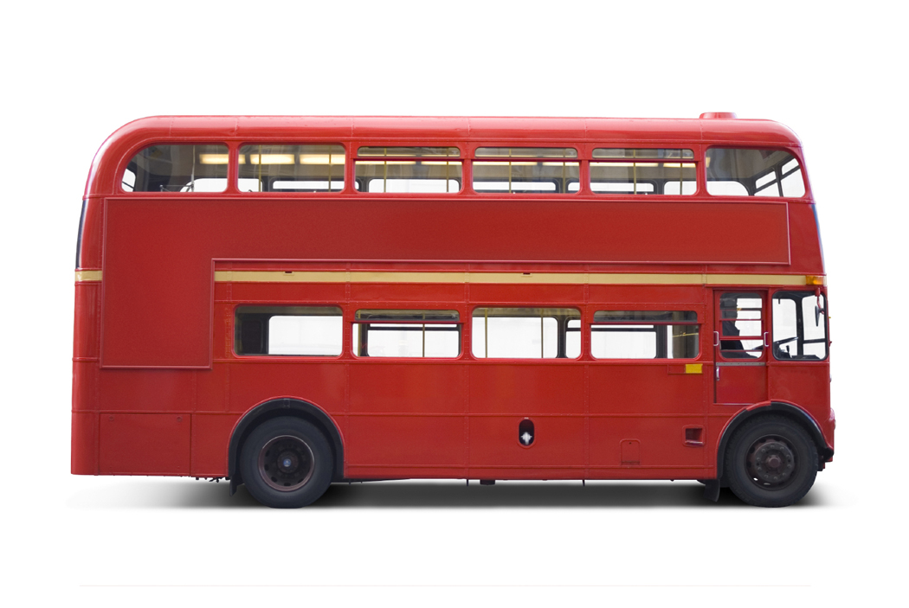
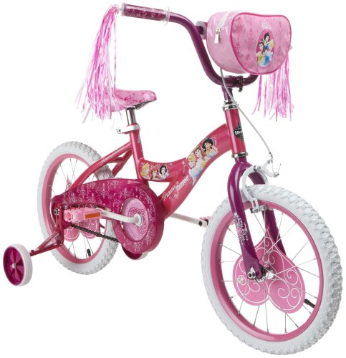
Red/Pink
hóng sè (红色) = red
fěn hóng sè (粉红色) = pink
fěn (粉) = powder

Slide 4
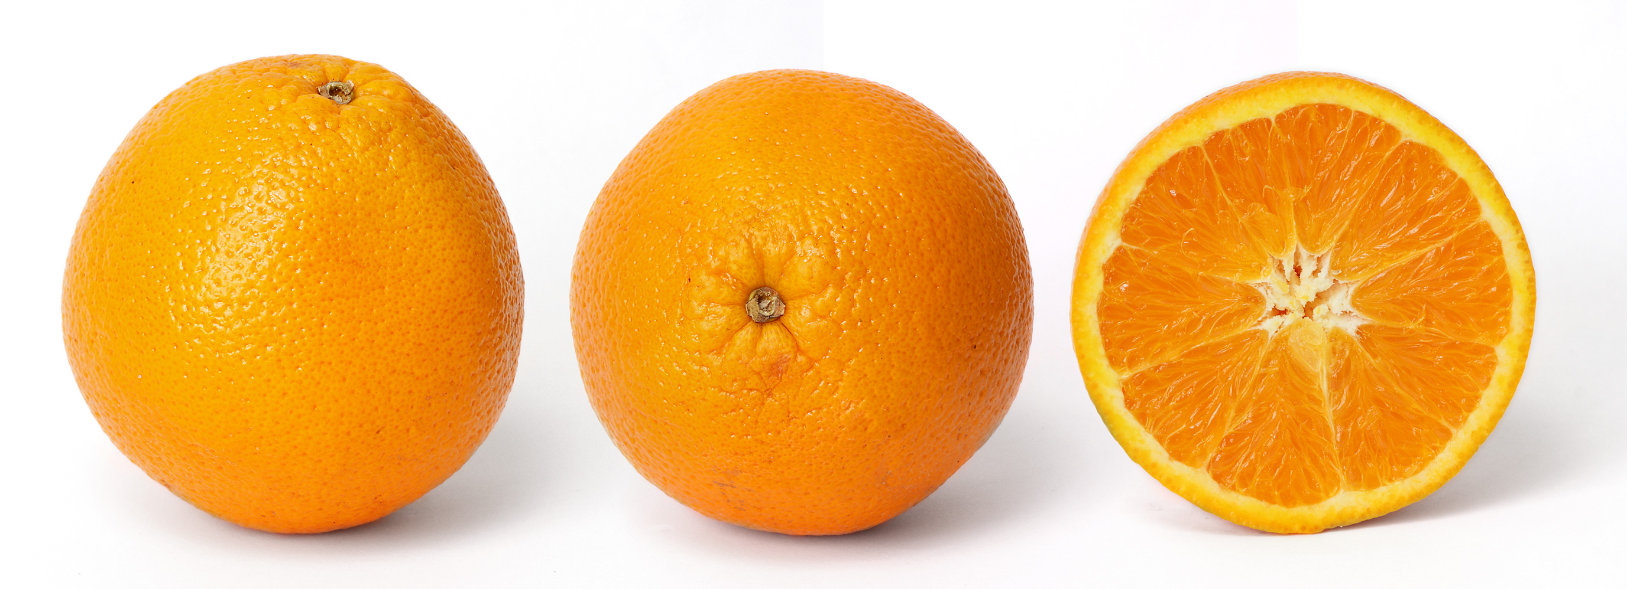
Orange
chéng sè (橙色) = orange
A chéngzi (橙子) is an orange (fruit).

Slide 5
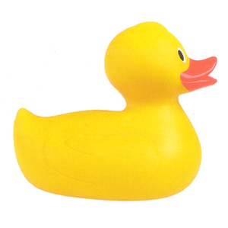
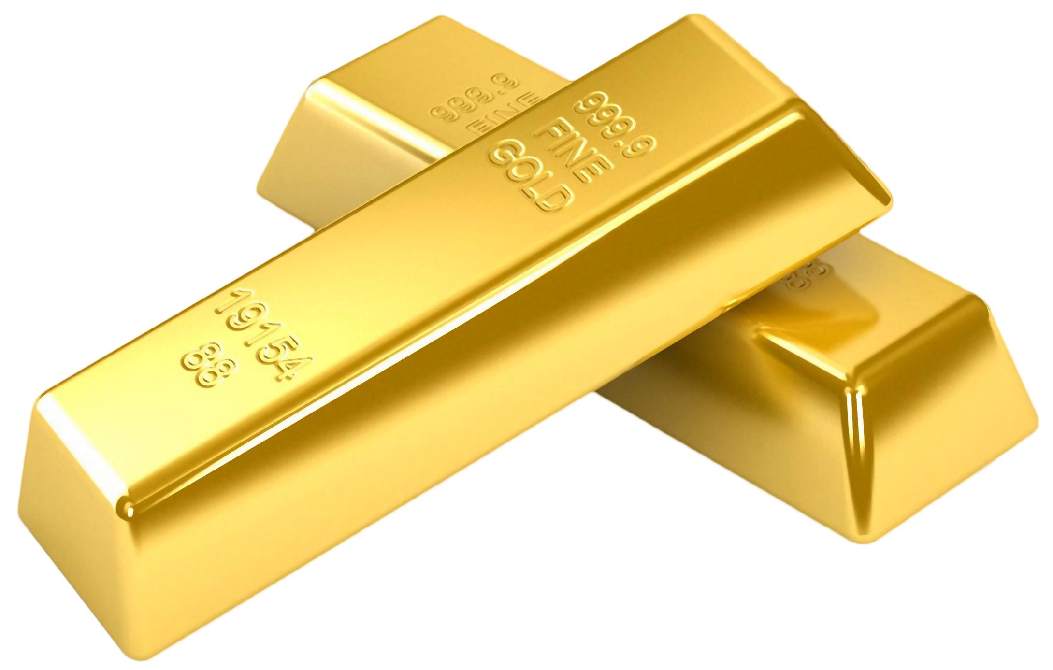
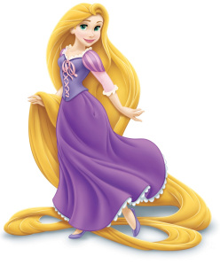
Yellow/Gold/Blonde
huáng sè (黄色) = yellow
jīn sè (金色) = gold
jīn huáng sè (金黄色) = blonde

Slide 6
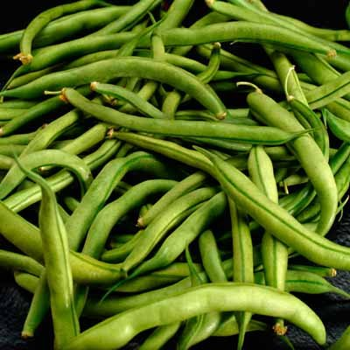
Green
lǜ sè (绿色) = green

Slide 7
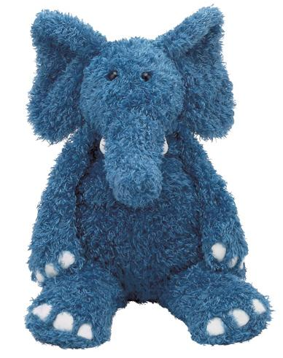
Blue
lán sè (蓝色) = blue

Slide 8
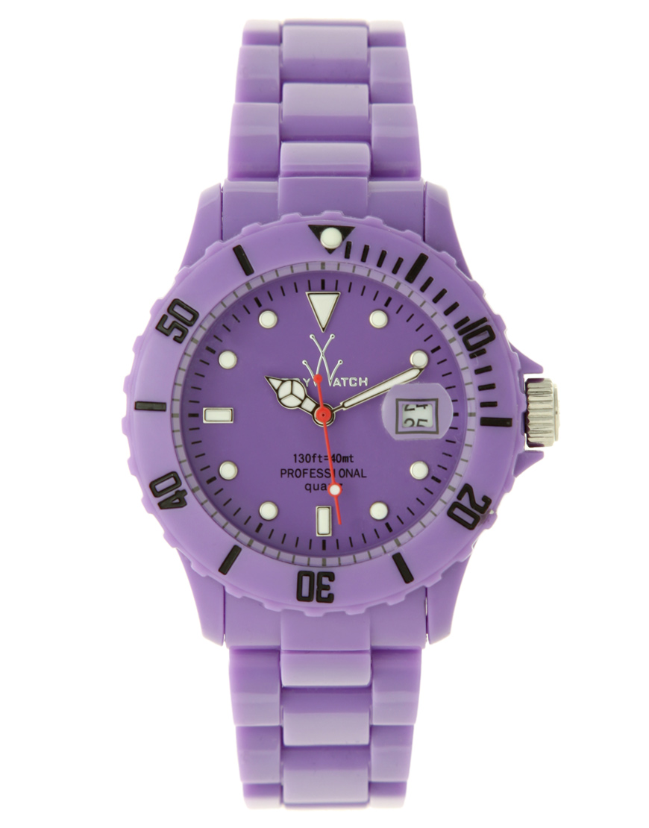
Purple
zǐ sè (紫色) = purple

Slide 9
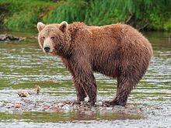
Brown
zōng sè (棕色) = brown
You can also use: kāfēi sè (咖啡色) = coffee colored
(usually to indicate a lighter brown)

Slide 10
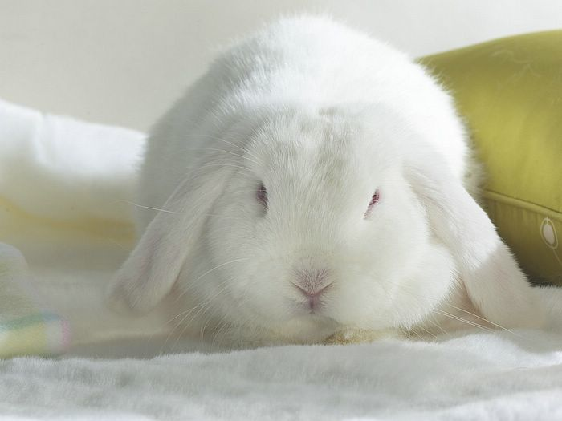
White
bái sè (白色) = white

Slide 11
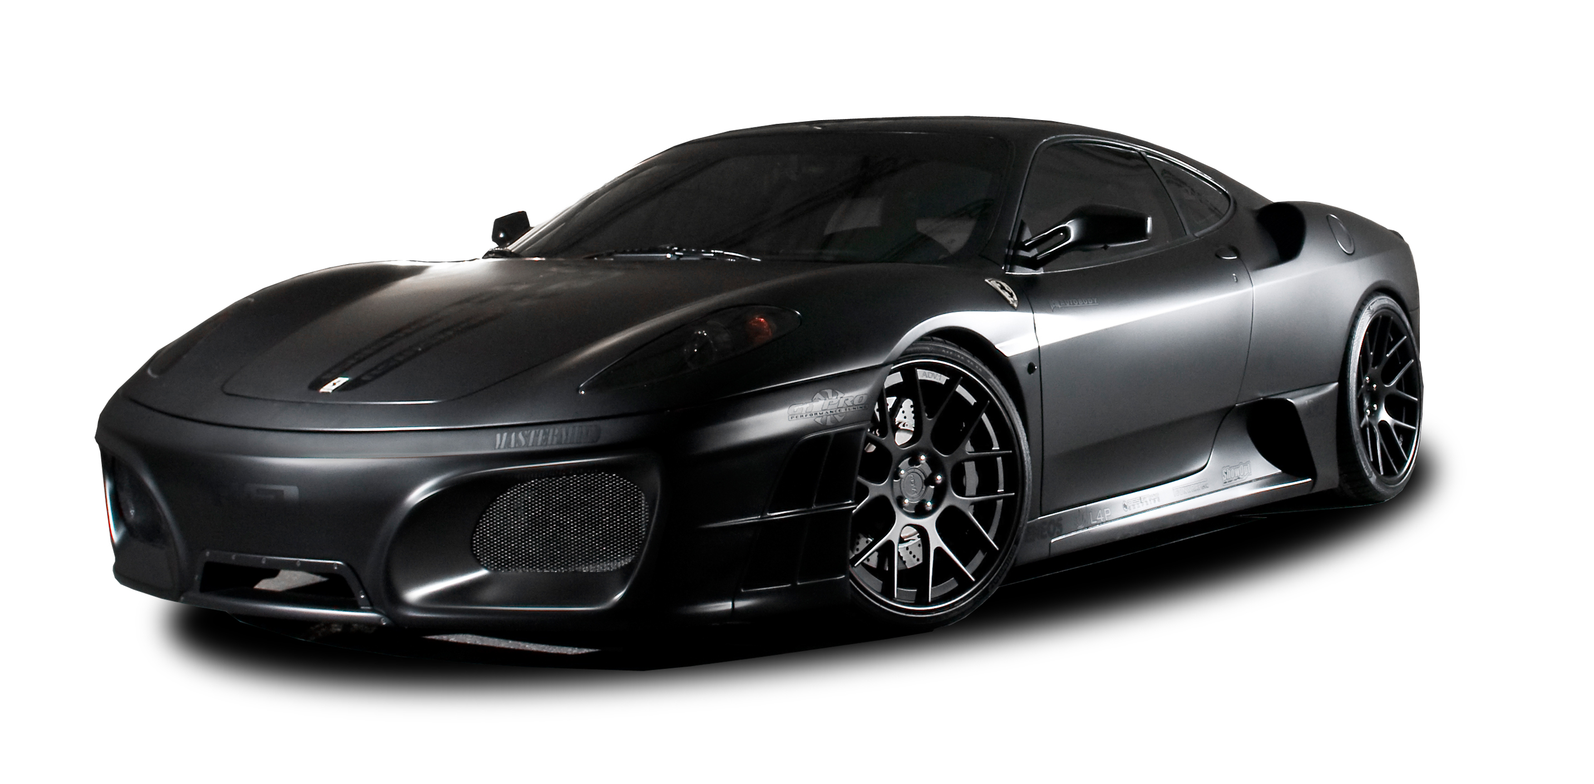
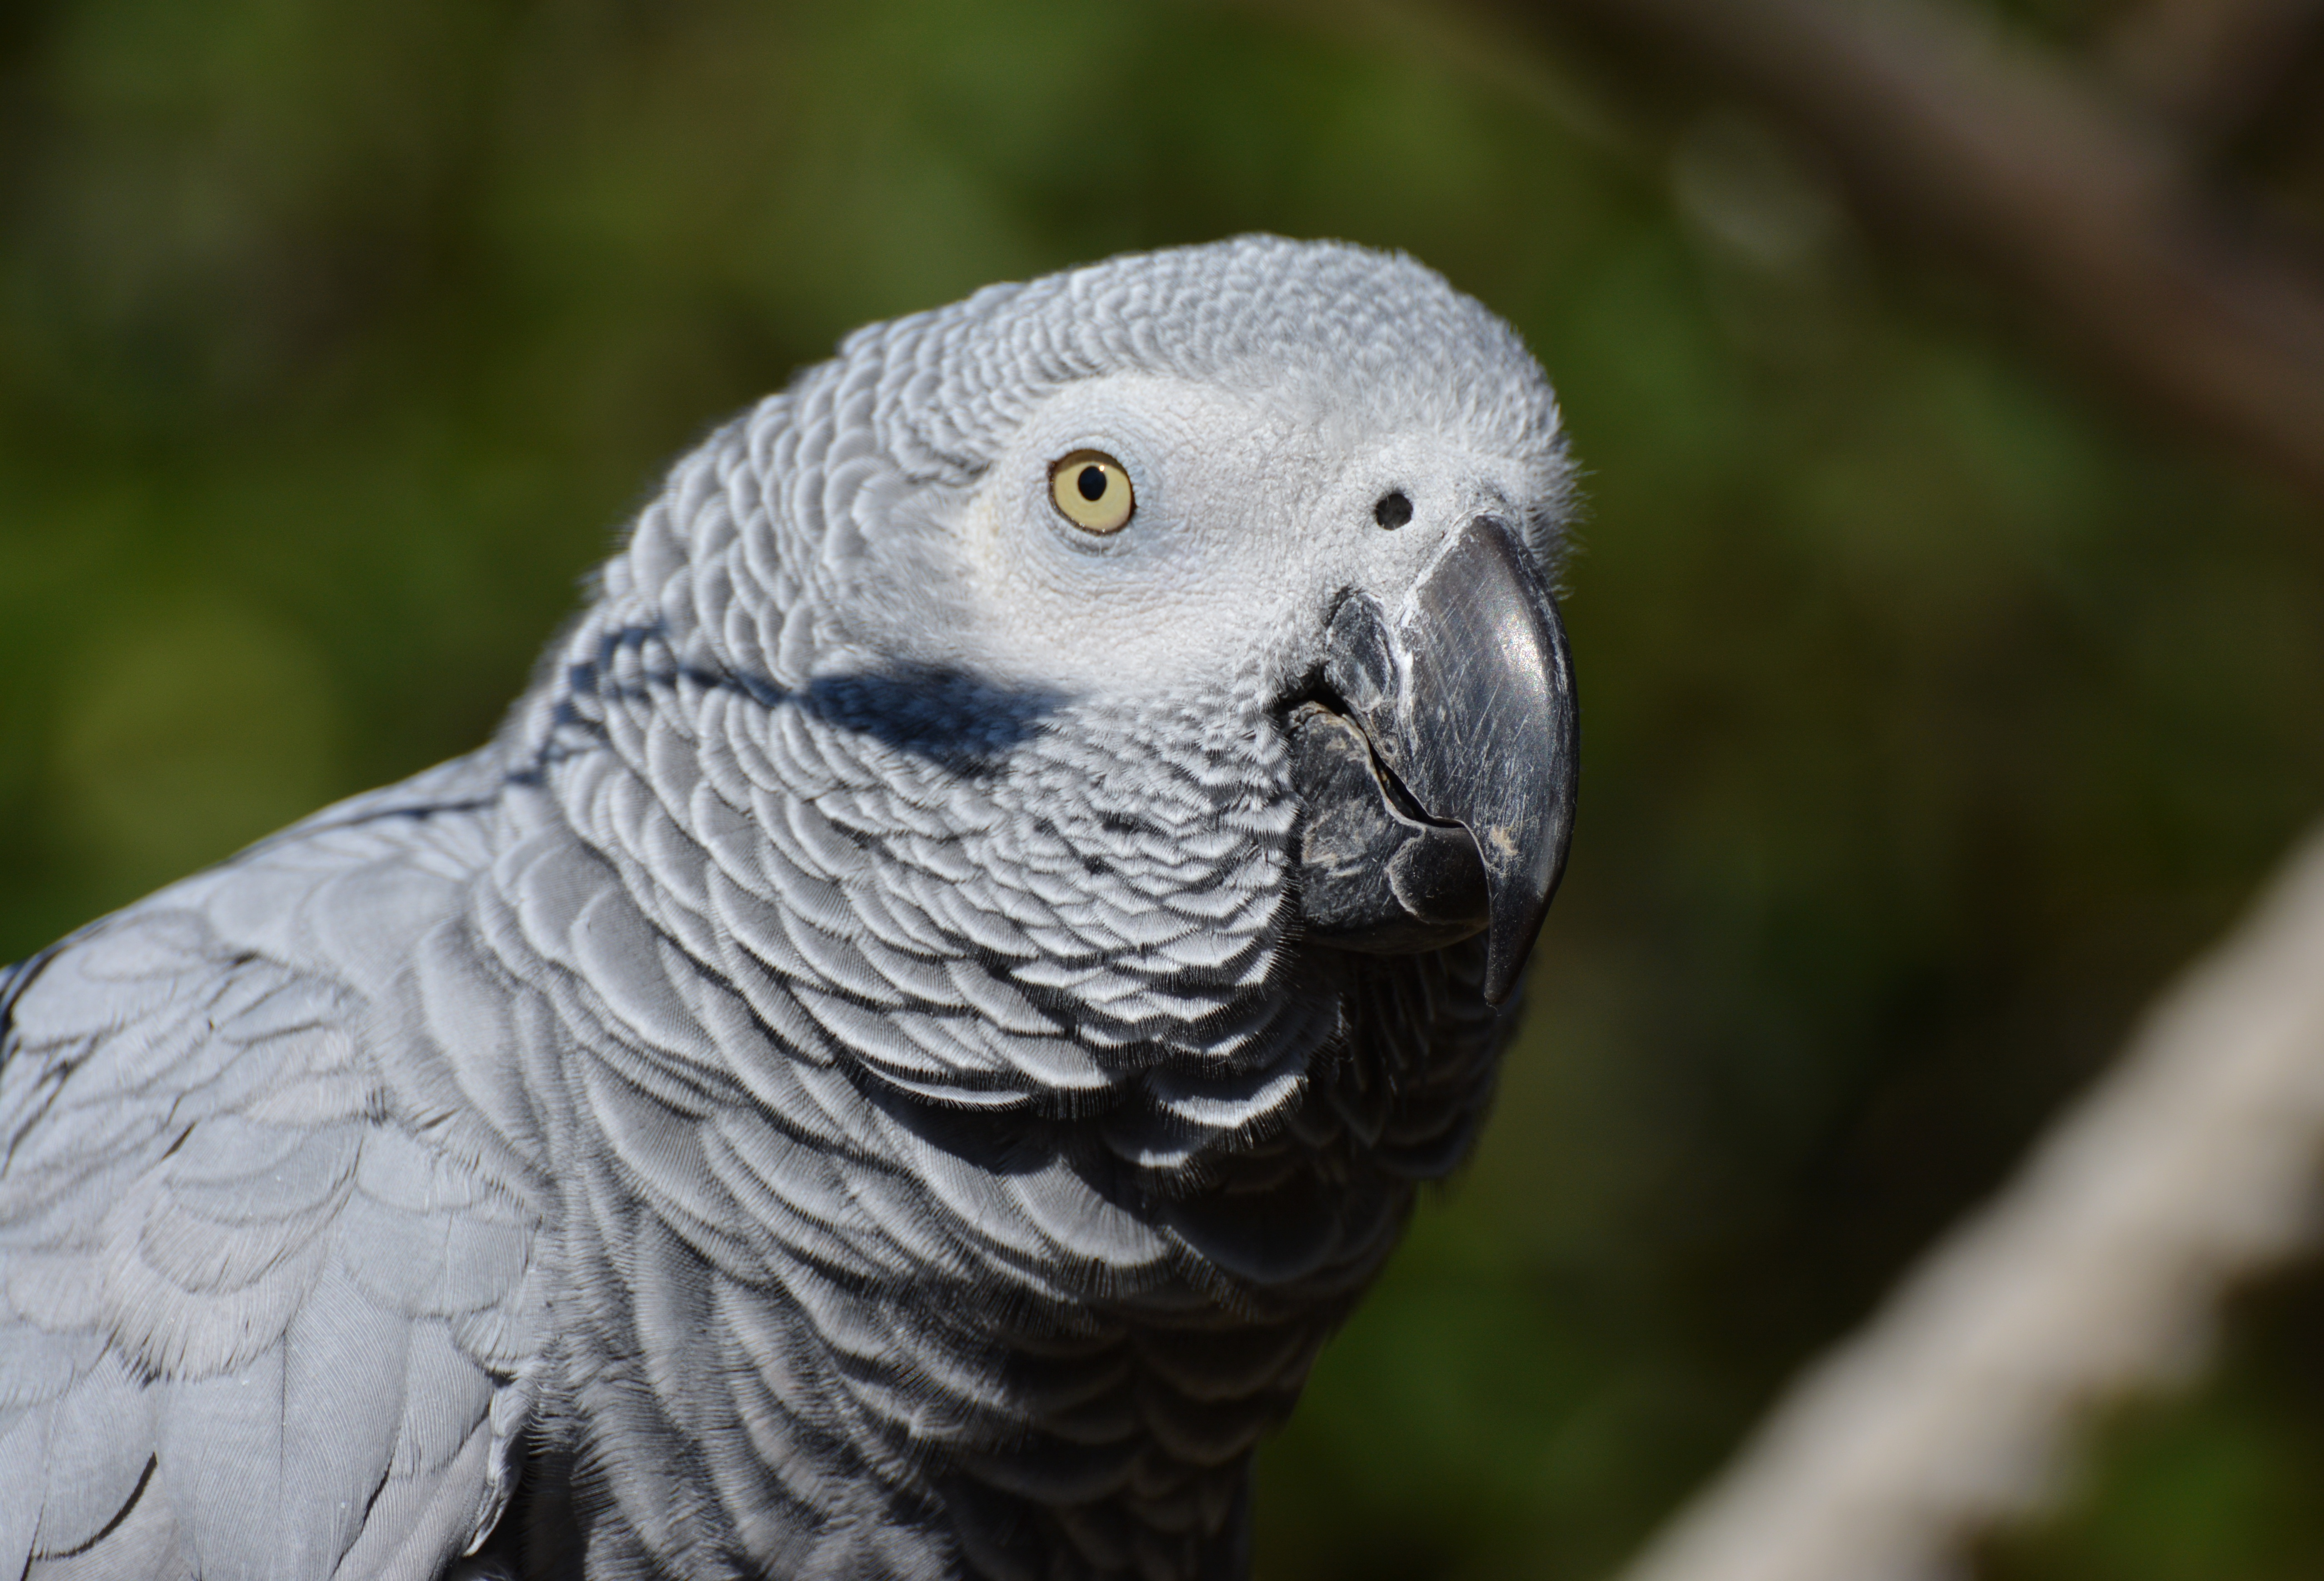
Black/Gray
hēi sè (黑色) = black
huī sè (灰色) = gray

Slide 12
Light/Dark
qiǎn sè (浅色) = light
shēn sè (深色) = dark

Slide 13
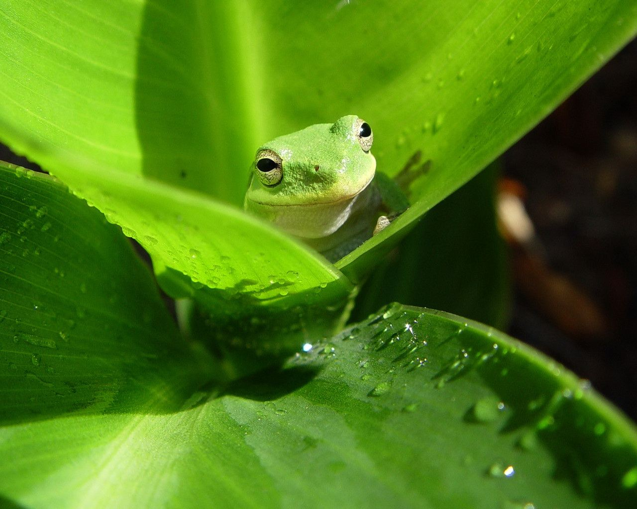
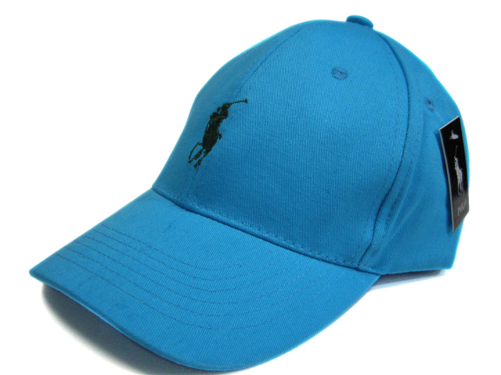
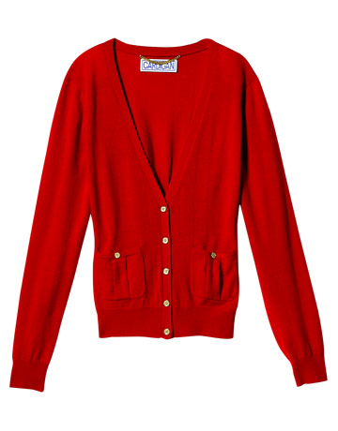
What Color? Shén me yánsè? (什么颜色)

