Slide 1
How did World War II change Europe and the world?
Essential Question:
Standard: SS6H7b. Explain the impact of WWII in terms of the Holocaust, the origins of the Cold War, and the rise of Superpowers.
Notes:
Instructional Approach(s): The teacher should introduce the essential question and the standard that aligns to the essential question.

Slide 2
Activating Strategy: World War II Placemat
In each corner of the World War II Placemat, students will write information they already know about World War II. Such as why it started, who won, effects of World War II, etc.
Notes:
Instructional Approach(s): The teacher should facilitate the World War II Placemat Activator [linked on the curriculum map]. The teacher should be walking around listening and redirecting discussions as needed. The teacher can briefly discuss student responses.

Slide 3
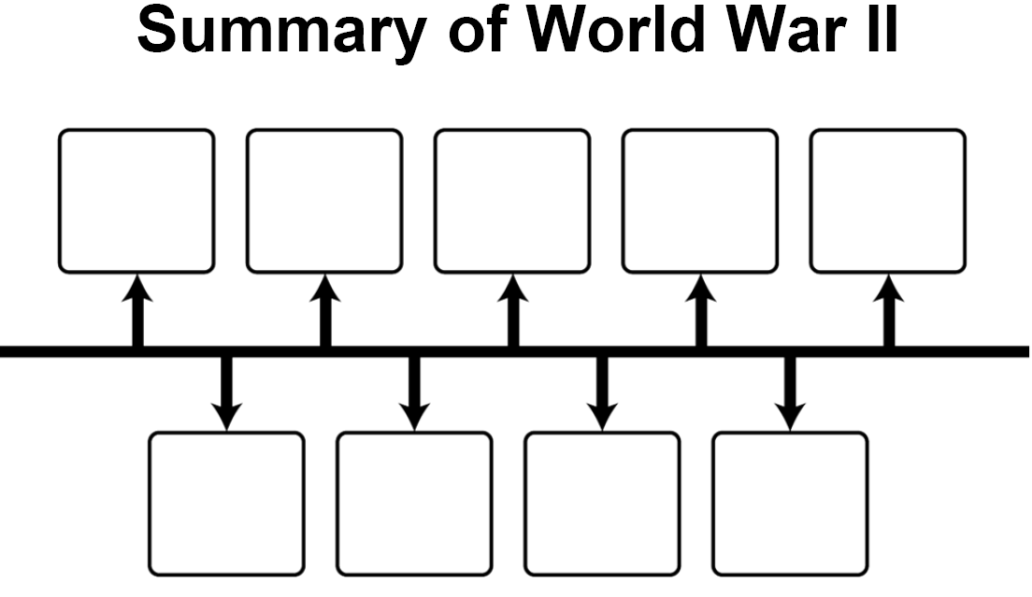
Summary of World War II
Read the Summary of World War II provided by the teacher and make a timeline of the major causes and events of World War II.
Notes:
Instructional Approach(s): The students do not need to know the cause and events of WWII. Rather, the standard asks students to explain the impact of WWII. However, it is beneficial to give students a general summary of World War II to better understanding its impact. Therefore, the teacher should select one of the World War II summaries [linked on the curriculum map] for students to use to create a general timeline of events (does not have to include dates) for World War II. The students can work individually or with a partner. The partner can be student selected or teacher selected (differentiated if needed).

Slide 4
Summary of World War II
http://www.youtube.com/watch?v=_O4Lf9qyuFo
Notes:
Instructional Approach(s): The teacher can show the video clip to illustrate the general events of World War II.

Slide 5
Use the World War II Graphic Organizer to take Notes
Notes:
Instructional Approach(s): The teacher should give each student a copy of the Impact of World War II Graphic Organizer [linked on the curriculum map] to record important information during the lesson.

Slide 6
Use the Summary of World War II and your Timeline to complete the World War II Summary on your graphic organizer.
Notes:
Instructional Approach(s): Each student should use their timeline to create a summary of World War II on their graphic organizer. The teacher may want to allow students to share their summary with another student when finished. Share a few student responses before moving to the next slide which provides a sample summary. Do not allow more than 10 minutes total to summarize and share.

Slide 7
After World War I, strong dictatorships took hold in Germany, Italy, and Japan. These governments started taking over countries surrounding them and together formed an alliance. When Germany attacked Poland, opposing countries finally declared war on these aggressive countries. The war ended in 1945 when Germany and Japan surrendered. The countries in Europe suffered terrible destruction and loss of life.
Notes:
Instructional Approach(s): Have students read some of their summaries to the class before you show your summary. Tell students that they do not have to erase and change their summary. They may want to add to their own summary if needed.

Slide 8
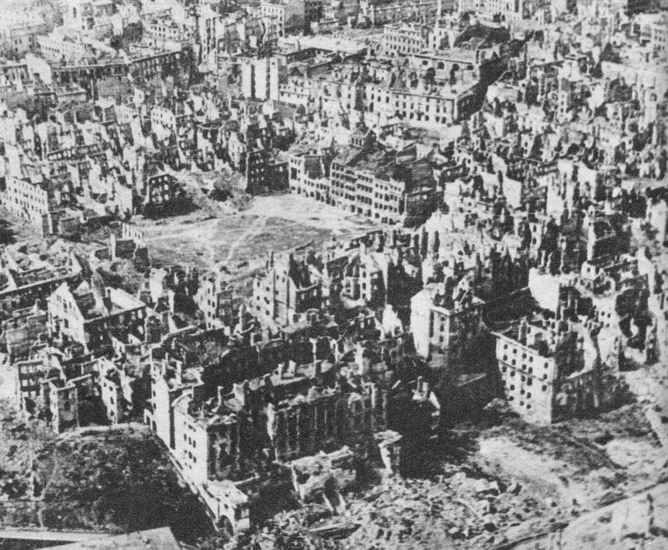
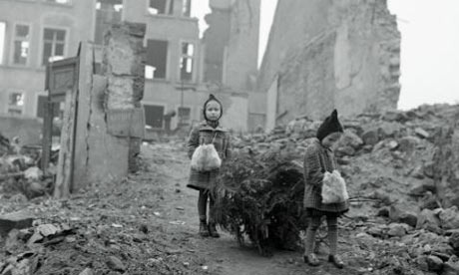
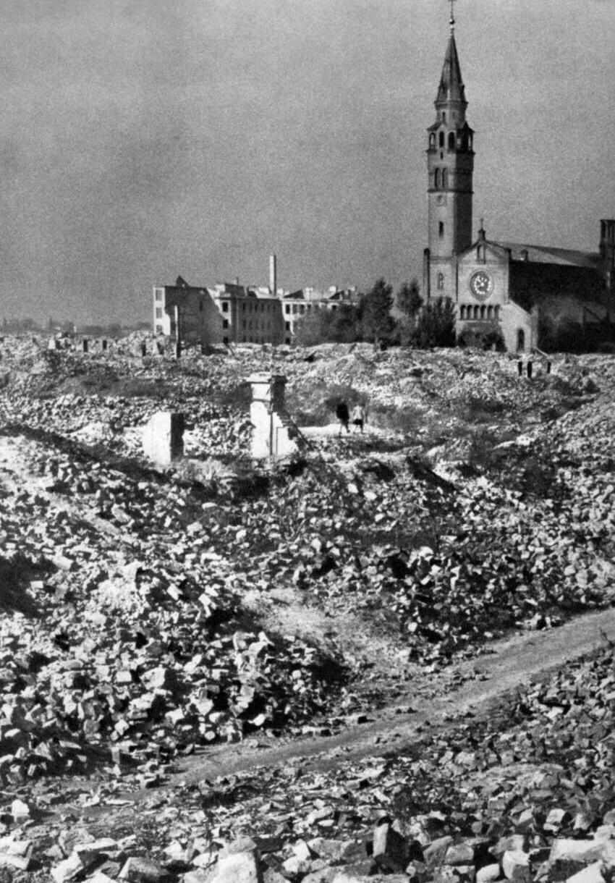
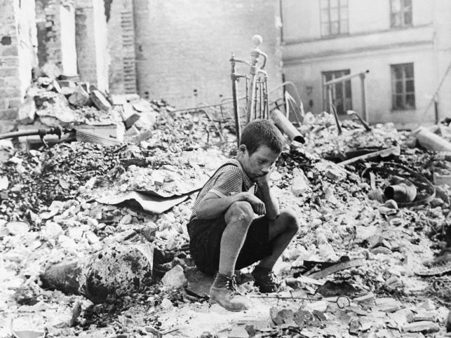
Impact of World War II
Many of the battles of World War II had been fought in Europe, and the countries were devastated by terrible destruction and loss of life.
Notes:
Instructional Approach(s): The teacher should present the information to the class.

Slide 9
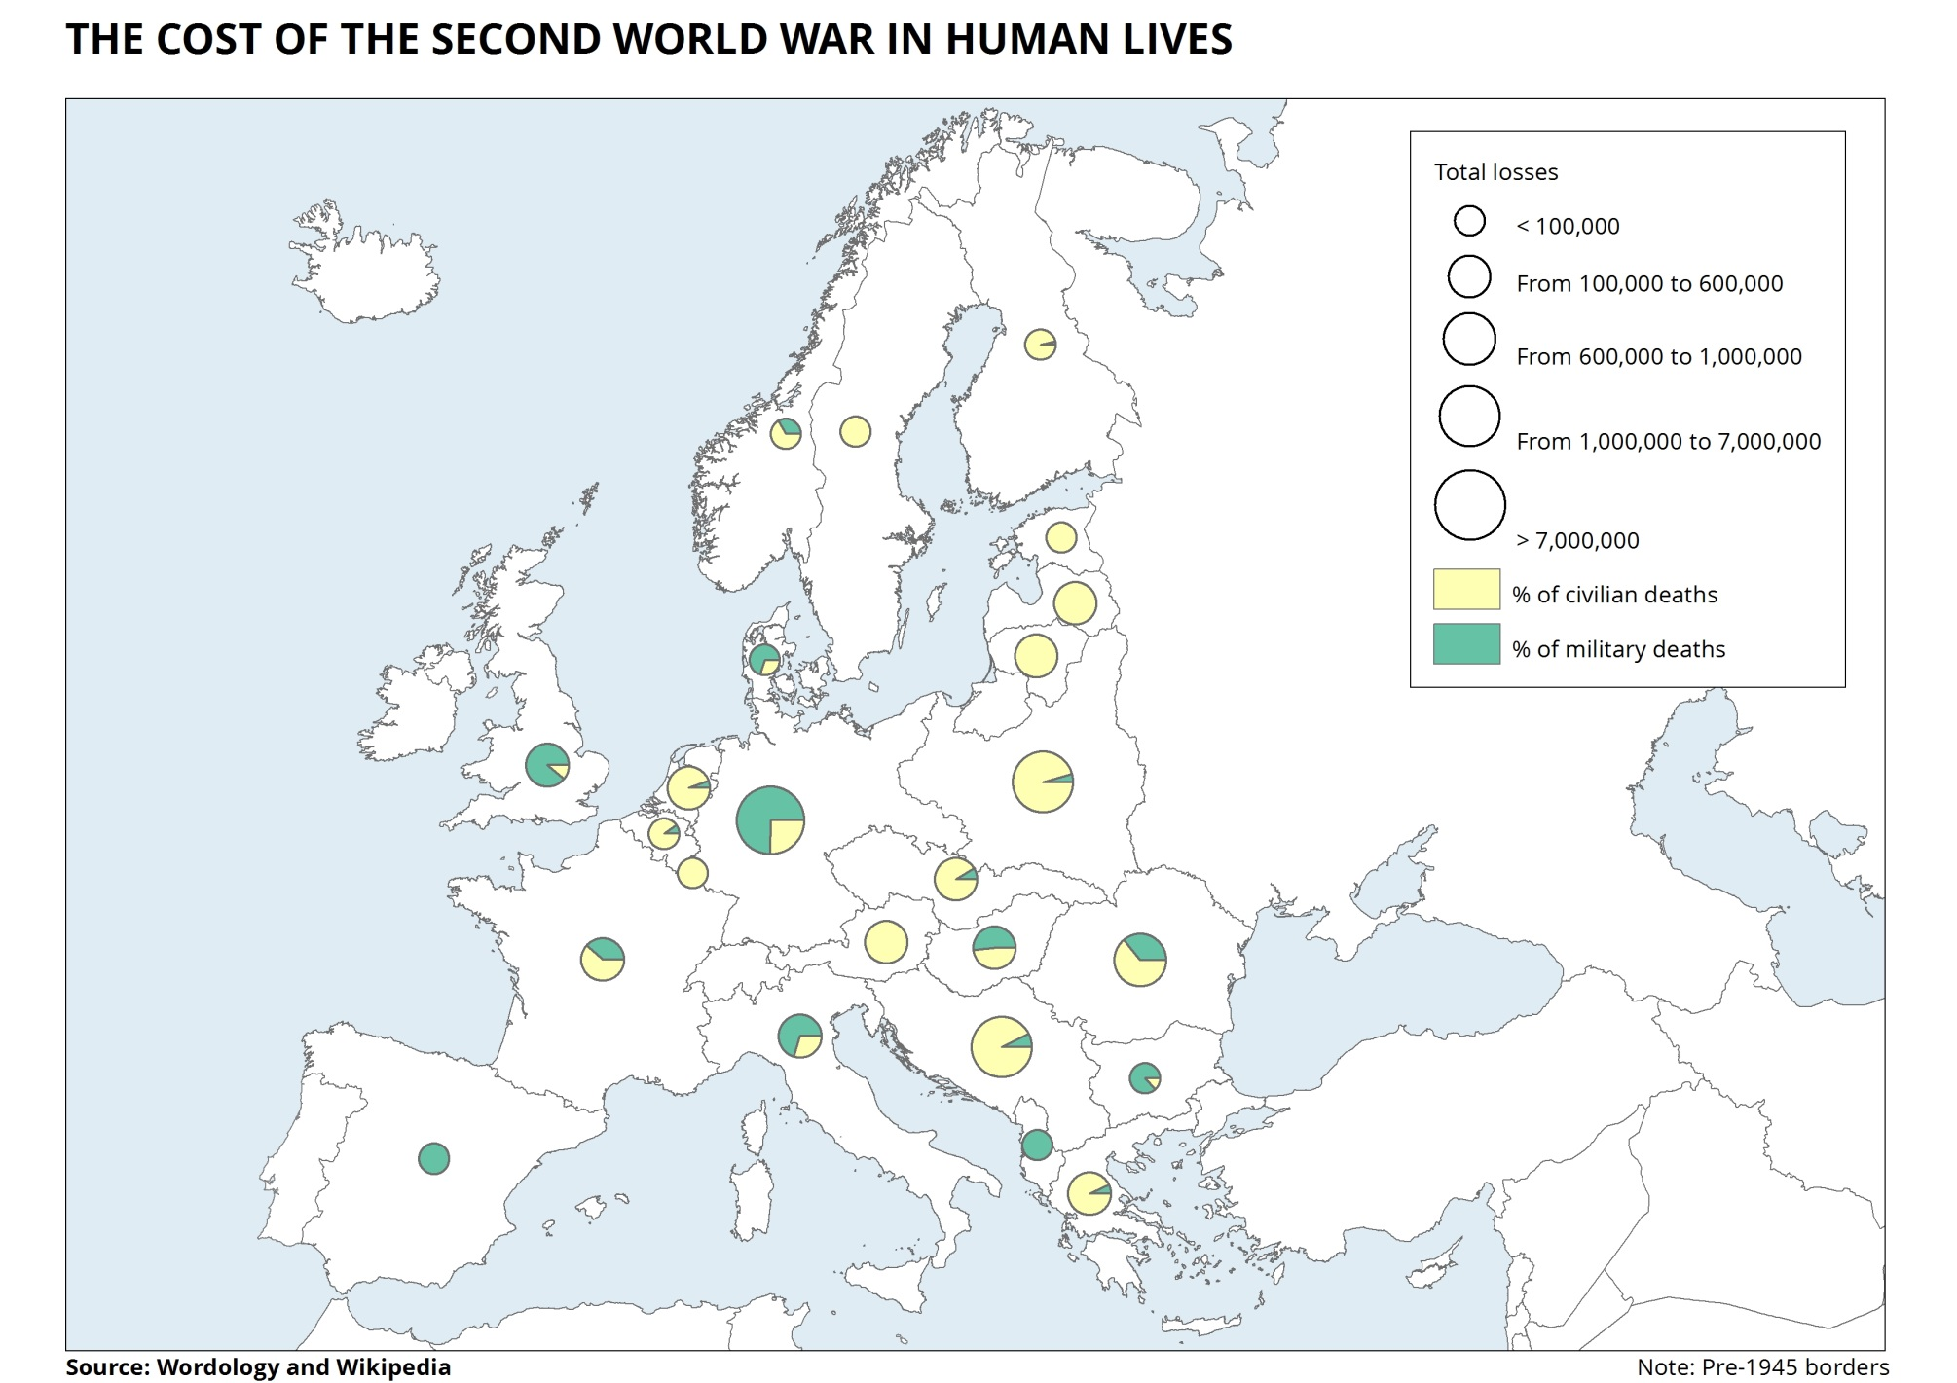
Notes:
Instructional Approach(s): The teacher should use the slide to illustrate the tremendous loss of human lives during WWII. Briefly discuss some of the losses with the class in terms of countries with the largest losses and why.

Slide 10
Impact of World War II
Hitler believed that his Aryan race was superior and he persecuted Jews in Germany. He hurt them first economically, then moved them out of their homes and into crowded areas. Finally, he forced them into concentration camps or death camps where they were murdered.
Hitler was responsible for the murder of more than six million Jews between 1933 and 1945. This terrible period of history is known as the Holocaust.
http://www.youtube.com/watch?v=9VGU9gMoNSA
Notes:
Instructional Approach(s): The teacher should present the information on the slide. The students can summarize the information on their graphic organizer, or the teacher may wait until Slides 23-24 where a summary of the impact of World War II provides more general statements.

Slide 11
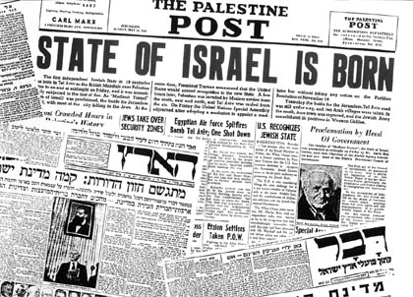
Impact of World War II
After the war, Holocaust survivors were afraid to go back to their former homes. When the State of Israel was established in 1948, thousands of Jewish people filled their new homeland.
Notes:
Instructional Approach(s): The teacher should present the information on the slide. The students can summarize the information on their graphic organizer, or the teacher may wait until Slides 23-24 where a summary of the impact of World War II provides more general statements.

Slide 12
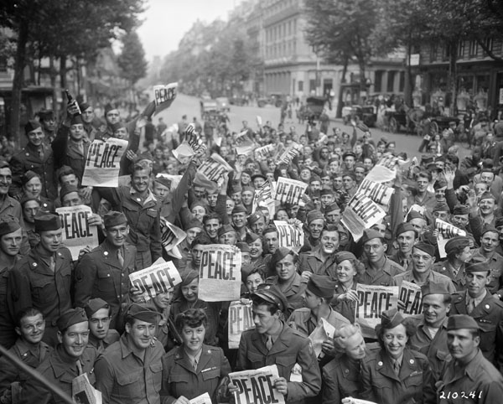
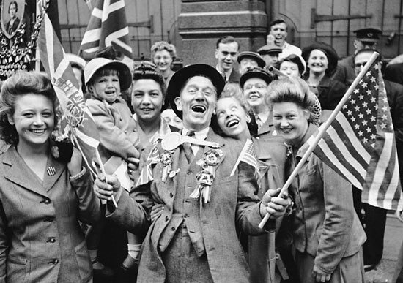
Impact of World War II
At the end of World War II, the Allied forces (Great Britain, France, the Soviet Union, and the U.S.) freed all the nations in Western Europe that had been conquered by Germany. Additionally, the Allied forces helped the countries form new governments and gave them money to rebuild their cities.
Notes:
Instructional Approach(s): The teacher should present the information on the slide. The students can summarize the information on their graphic organizer, or the teacher may wait until Slides 23-24 where a summary of the impact of World War II provides more general statements.

Slide 13
Impact of World War II
The U.S. and other Allied countries wanted to establish democratic governments and free-market economies in the newly freed European countries.
The Soviet Union wanted to establish communist governments with centralized economic and political systems.
Notes:
Instructional Approach(s): The teacher should present the information on the slide. The students can summarize the information on their graphic organizer, or the teacher may wait until Slides 23-24 where a summary of the impact of World War II provides more general statements.

Slide 14
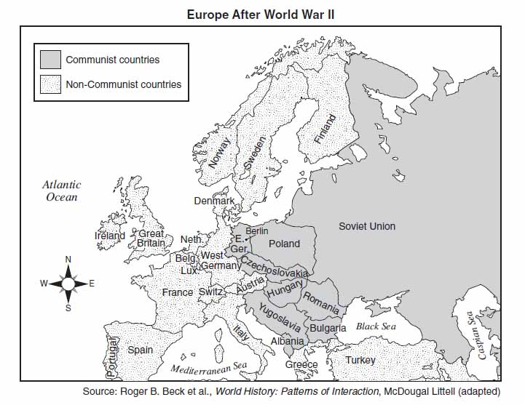
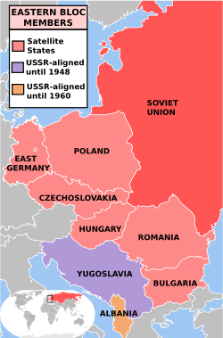
Impact of World War II
At the end of World War II, the Western half of Europe favored democracy while the Eastern half of Europe favored communism. Soviet troops moved into countries like Poland, Romania, Hungary, and the eastern half of Germany and set up communism.
Notes:
Instructional Approach(s): The teacher should present the information on the slide. The students can summarize the information on their graphic organizer, or the teacher may wait until Slides 23-24 where a summary of the impact of World War II provides more general statements.

Slide 15
Capitalism vs Communism - Freedom versus Oppression - Propaganda Cartoon - Cold War 1940s
http://www.youtube.com/watch?v=bZou8mgDSs8
Discuss the following questions with a partner:
Propaganda means information that is used to promote a point of view. Which side, capitalism or communism, did the video promote?
Describe an advantage and disadvantage of both systems.
In which system would you want to live? Why?
Notes:
Instructional Approach(s): The teacher should show the video clip then have students turn to a partner and discuss the questions on the slide. Partners can be determined by the students or the teacher can provide more specific directions such as turn to the person directly in front/behind you or to the right/left of you, etc. It may be necessary to have a group of three if you have an uneven number of students. Do not allow more than 1-2 minutes of discussion time. The teacher should be walking around listening and redirecting discussions as needed. The teacher can briefly discuss student responses.

Slide 16
World War II Political Cartoon Analysis
Notes:
Instructional Approach(s): The teacher should facilitate the World War II Political Cartoon Analysis Task [linked on the curriculum map].

Slide 17
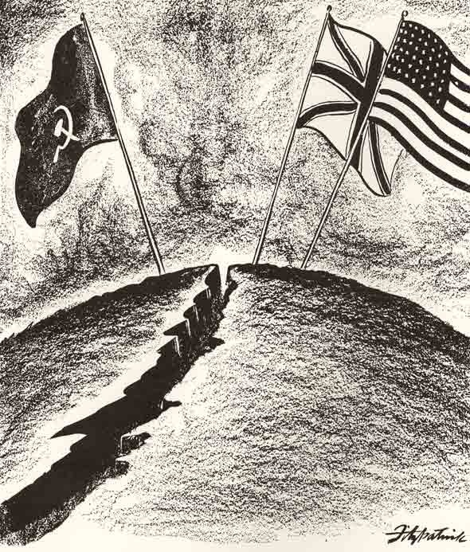
Impact of World War II
After World War II, distrust developed between the U.S. and the Soviets.
The U.S. did not like the way the Soviets were expanding their territory.
The two countries had different beliefs and political systems.
Notes:
Instructional Approach(s): The teacher should present the information on the slide. The students can summarize the information on their graphic organizer, or the teacher may wait until Slides 23-24 where a summary of the impact of World War II provides more general statements.

Slide 18
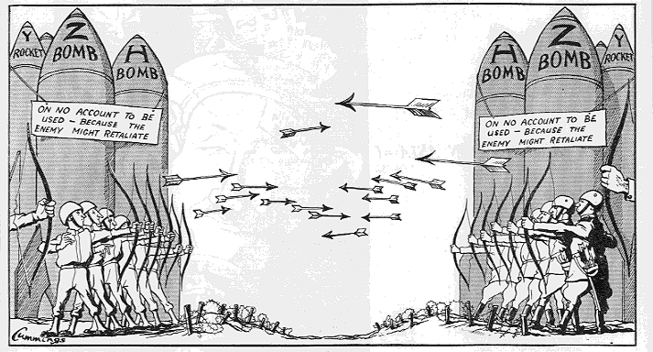
Impact of World War II
The U.S. and the Soviet Union both “stockpiled” weapons in case of war.
Notes:
Instructional Approach(s): The teacher should present the information on the slide and use the picture to illustrate the concepts.

Slide 19
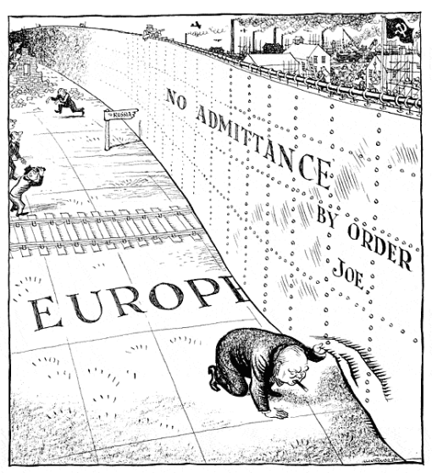
Impact of World War II
The state of tension between the U.S. and the Soviet Union became known as the “Cold War” because it never involved fighting.
The British Prime Minister, Winston Churchill, warned that an “Iron Curtain” had fallen across the continent of Europe, meaning that a dividing line now existed between Eastern and Western Europe.
Notes:
Instructional Approach(s): The teacher should present the information on the slide. The students can summarize the information on their graphic organizer, or the teacher may wait until Slides 23-24 where a summary of the impact of World War II provides more general statements.

Slide 20
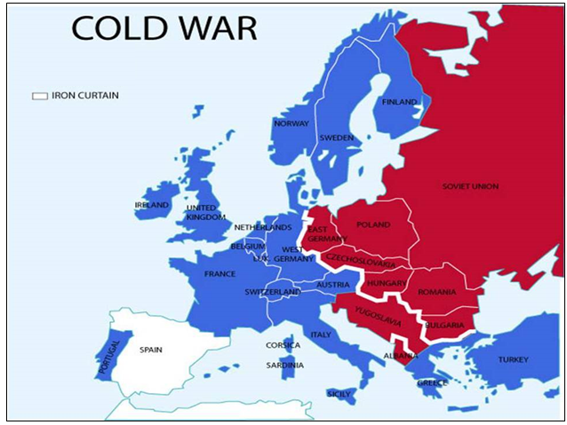
Notes:
Instructional Approach(s): The teacher should use the picture to illustrate the “iron curtain” which was an imaginary line that divided Europe between democratic countries and communist countries.

Slide 21
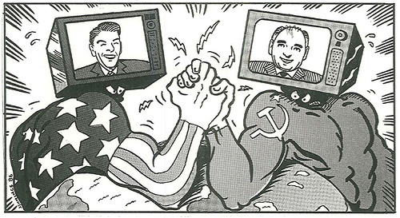
Which two countries are represented in the political cartoon below?
The political cartoon illustrates the mood after World War II. What do you think it means?
Notes:
Instructional Approach(s): The teacher should pose the questions on the slide to the class. The teacher can ask for volunteers or call on students to answer the questions.

Slide 22
After World War II, the United States and the Soviet Union emerged as the world’s two “Superpowers” with the military and political strength to influence worldwide events.
Impact of World War II
Notes:
Instructional Approach(s): The teacher should present the information on the slide. The students can summarize the information on their graphic organizer, or the teacher may wait until Slides 23-24 where a summary of the impact of World War II provides more general statements.

Slide 23
Impact of World War II: Summary
The Holocaust was a period during the World War II era in which millions of Jews were murdered or displaced
The U.S. and the Soviet Union both fought on the same side during WWII, but became bitter enemies engaged in an extremely tense time of political hostility and nuclear build-up called the Cold War
Notes:
Instructional Approach(s): The teacher should present the information on the slide while the students record the information on their graphic organizer (if needed).

Slide 24
Impact of World War II: Summary
The U.S. wanted to rebuild European states with democratic governments and free market economies.
The Soviet Union wanted to rebuild European states with communist governments with centralized economic and political systems
The U.S. and the Soviet Union became “Superpowers” because of their military and political ability to influence other countries.
Notes:
Instructional Approach(s): The teacher should present the information on the slide while the students record the information on their graphic organizer (if needed).

Slide 25
Notes:
Instructional Approach(s): Each student should complete the summarizer. The teacher should use the summarizer to determine the level of student mastery and if differentiation is needed.

