Slide 1
What is Culture?
Watch the video below about culture.
https://www.youtube.com/watch?v=o32l-_U6nGY

Slide 2
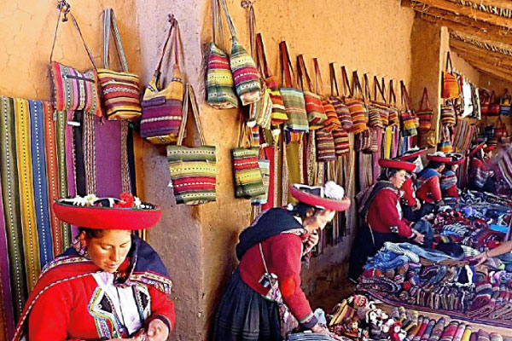
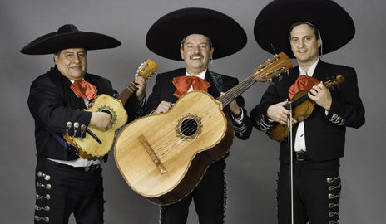
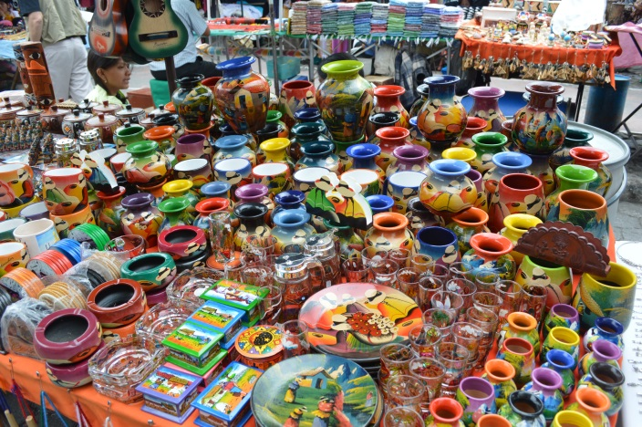
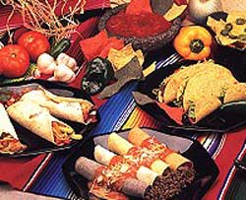
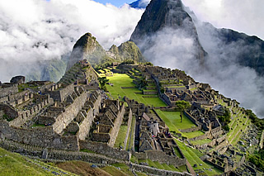
What comes to mind when you think about Latin America’s culture?

Slide 3
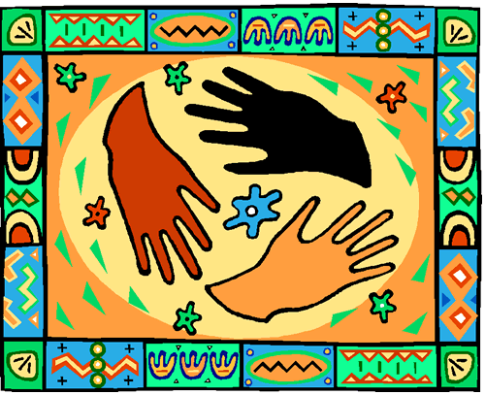
Latin America has a unique culture. Let’s examine some of the cultural characteristics of people who live in Latin America

Slide 4
Essential Question: What are the cultural characteristics of people who live in Latin America?

Slide 5
Standards:
SS6G4a. Describe the results of blending of ethnic groups in Latin America and the Caribbean.
SS6G4b. Explain why Latin America is a region based on the languages of Portuguese and Spanish.
SS6H2b. Describe the influence of the Spanish and the Portuguese on the language and religions of Latin America.

Slide 6
Background
Recall our studies earlier in the year on European exploration.
Think, Pair, Share – What were the three main reasons for exploration?

Slide 7
Latin American Culture Investigation

Slide 8
Use your Graphic Organizer to record Notes

Slide 9
During European exploration and colonization, European countries that conquered other regions often usurped [took over] the native language and religion of that region.
This is true for Latin America.

Slide 10
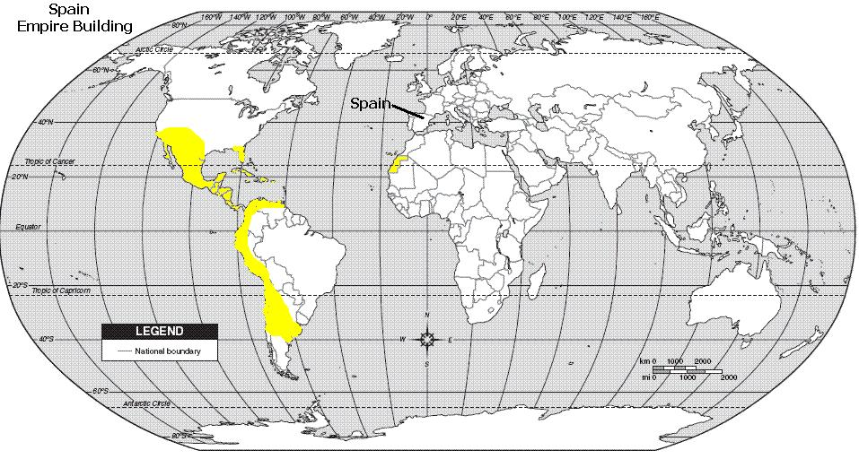
Languages of Latin America
Most Latin American countries speak Spanish because Spain built an empire in most Latin American countries.

Slide 11
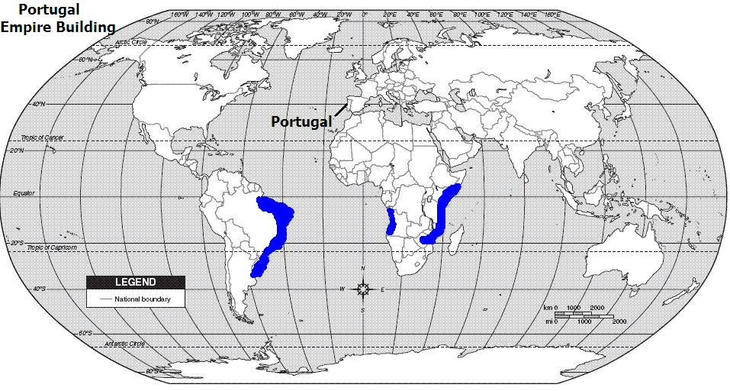
Languages of Latin America
Portuguese is spoken in Brazil because Portugal built an empire in this area.

Slide 12
The name Latin America comes from the fact that Spanish, Portuguese and French came from the Latin language.
These languages are called Romance languages because they all came from medieval [out-of-date] Latin dialects [languages] spoken in areas of Europe ruled by the Roman Empire.
Notes:
Teachers this terminology is difficult, but it is the terminology used in the Teacher Notes. Expose the students to the information, but it is put in more simplistic terms on the next slide.

Slide 13
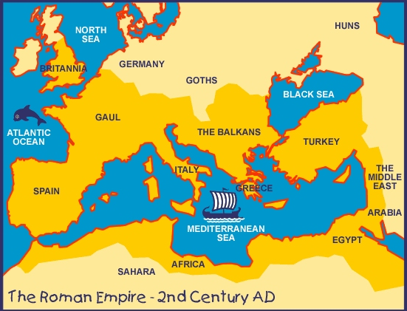
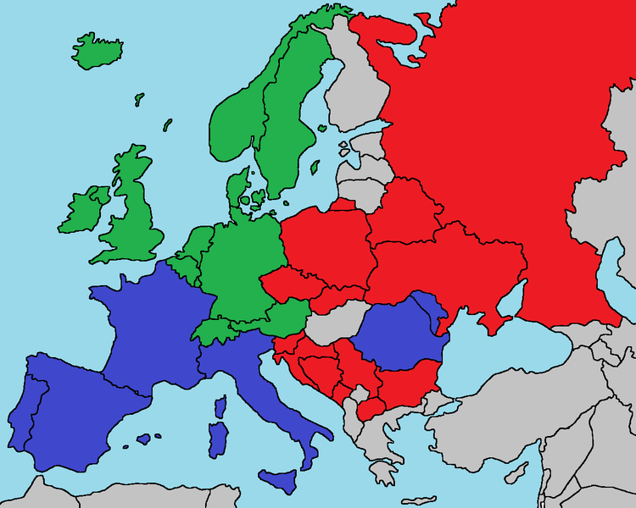
History of Romance Languages
Roots of European Languages
Slavic Languages
Germanic Languages
The Spanish and Portuguese languages are called Romance languages because they came from old languages used during the Roman Empire.
Romance Languages

Slide 14
Religion in Latin America
Latin America’s dominant religion is Roman Catholicism. Over 90% of people in the region claim to be Catholic.
Catholic values and attitudes are part of life in almost every country in Latin America.

Slide 15
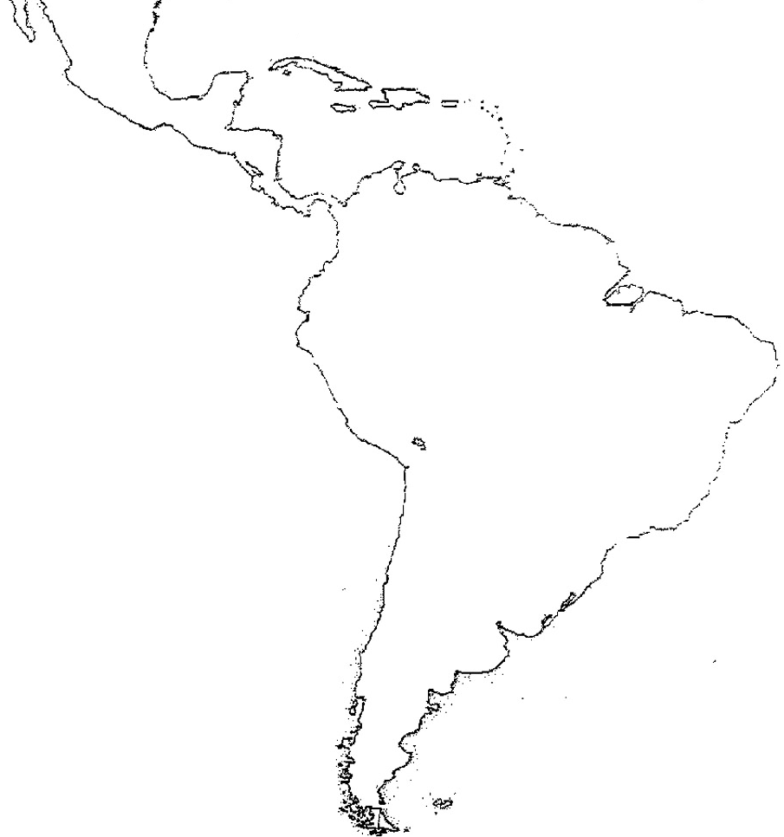
If you lived here which language would you speak? Why? Which religion?
Notes:
Call on several students to answer. Or, have them turn to an elbow partner to see if they agree.

Slide 16
Although Latin America has the same basic language and religion, its culture is very diverse. What caused this diversity?
European colonization not only brought changes in language and religion to Latin America, it also influenced other aspects of culture.

Slide 17
The people and culture of Latin America are an interesting blend of the indigenous [native] people and the countries that established colonies there.
Once Europeans settled in Latin American, ethnic groups began to blend together.

Slide 18
What’s an ethnic group?
An ethnic group shares many common characteristics such as language, physical appearance, customs, and traditions.

Slide 19
Think, Pair, Share: Identify a group that could be considered an ethnic group.
Italian, Hispanic, Asian, Arab, Dutch, Greek, Irish, Persian, etc.

Slide 20
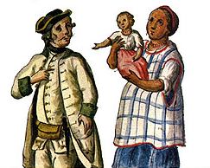
The American Indians [indigenous people] married Spanish people.
Mestizos were the people of mixed European and Indian ancestry.

Slide 21
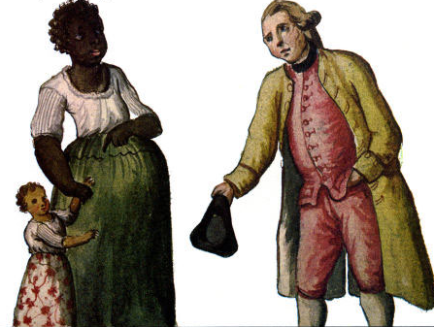
The Europeans also married black slaves that were brought to Latin America from Africa.
Mulattoes are people of mixed black & European descent.

Slide 22
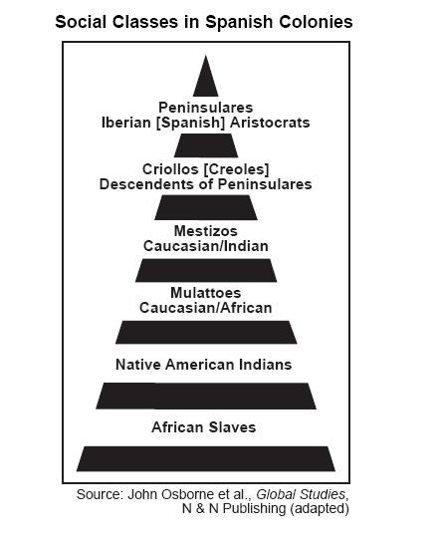
Spaniards born in Spain
Spaniards born in Spain

Slide 23
Geography of the World: Latin America: The People [22 minutes]

Slide 24
Summarizer: Describe how European settlers influenced the language, religion, and culture of Latin America.

