Slide 1
Food/Restaurant Unit
(Etiquette and How-To’s at a Restaurant)
By: 高老师

Slide 2
Food Culture in China
Family style
Expect to see lots of food left over on the table.
Providing plenty of food shows that the hosts are both wealthy and generous enough to feed their guests well.
Communication between service staff and patrons is very direct.
There’s little small talk since you aren’t family.
They’re on a mission to feed everyone, so this is especially true when they’re busy.
The Chinese character 饿 (è — hungry) is made up of two parts:
饣(shí — food) and 我 (wǒ — me).
So just telling someone you’re hungry is straightforward information: Food me!

Slide 3
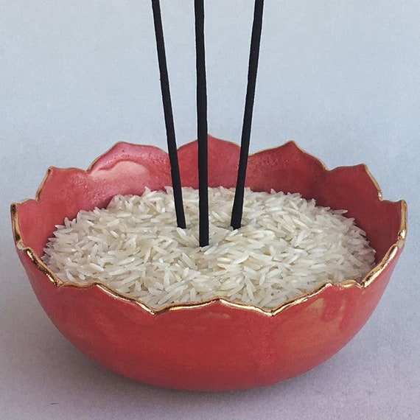
Chopsticks Culture in China (continued)
Chopsticks (and spoons for soup) are predominantly used.
Do not use chopsticks separately.
Always lay your chopsticks down. Do not stick them straight up in a bowl of rice.
To eat rice with chopsticks, you would scoop it into your mouth with chopsticks by picking up the bowl.

Slide 4
Different Places to Eat
A cān tīng (餐厅)
Larger-scale or fine dining restaurant
Doesn’t differ much from a nicer restaurant in a Western country.
Waiters will be well-dressed, a hostess will welcome you, complimentary tea will be provided and the lighting and decor will be nice.
A fàn guǎn (饭馆)
Casual restaurant
Much less formal than a regular restaurant.
All plates are individual.
Patrons are usually in and out, so the tables are freed up quicker for other people.
You pay first, then get your food.
Cafeteria style

Slide 5
Basics
qǐng (请) Please. (Only used at the beginning of a sentence, and never used on it's own.)
xiè xiè (nǐ)! (谢谢) Thanks/Thank you!

Slide 6
When You Walk In
WHAT YOU MIGHT HEAR:
huān yíng (欢迎) – Welcome
qǐng děng yī xià (请等一下) — Please wait a moment
jǐ wèi? (几位？) – How many people?
wèi = polite counter for guests/people
HOW YOU MIGHT RESPOND:
yī wèi (一位) One.
liǎng wèi (两位) Two.
sān wèi (三位) Three.
sì wèi (四位) Four.
etc.
wài mài (外卖)/ dài zǒu (带走) Takeout To-go

Slide 7
Flagging Someone Down
If you are eating at a restaurant in China, people may not even approach to take your order. Tipping at restaurants is not customary in China, therefore most servers do not provide individualized service to each table, and instead “man the floor.” That’s why you usually need to flag someone down for service.
WHAT YOU MIGHT SAY:
(While raising your hand) Fú wù yuan! (服务员!) Waiter!
Wǒmen yào diǎn cài! (我们要点菜!) We want to order!
diǎn cài = to order
HOW THEY MIGHT RESPOND:
Èi (诶!) Yes?/What would you like?
Mǎ shàng (马上!) Be right there!
Nǐ kěyǐ diǎn cài ma? (你可以点菜吗?) Are you ready to order?
Nǐ yào hē shěnme yǐnliào? (你要喝什么饮料.)
What do you want to drink?

Slide 8
Let’s Review from Previous Units
Counter/Classifiers
People
ge (个)
wèi (位)
Servings/dish/menu
Serving/counter for menu - fèn (份)
Plate - pán (盘)
For liquids (Drink (noun) – yǐnliào (饮料)
Cup - bēi (杯)
Bottle - píng (瓶)
Pot - hú (壶)
Sentence Structures
Yes/No Questions
[statement] + ma?
___ bú ___
What/shén me Questions
Subject + verb + shén me + (noun)

Slide 9
Yes/No Questions [statement] + ma?
“Do you have soda?”
You have soda, yes/no?
“Do you have a restroom?”
You have restroom, yes/no?
“Do you have a restroom I can use?”
You have restroom I can use, yes/no?
Nǐ yǒu kělè ma? (你有可乐吗？)
Nǐ yǒu cèsuǒ ma? (你有厕所吗？)
Nǐ yǒu cèsuǒ wǒ kěyǐ yòng ma? (你有厕所我可以用吗?)

Slide 10
Ordering (Part 1)
NEW VOCABULARY
ná (拿) – verb – to get
cài dān (菜单) – noun – menu
chá (茶)– noun – tea
yǐnliào (饮料) – noun – drink
jì kǒu (忌口) – noun – allergies/dietary restrictions
WHAT YOU MIGHT SAY:
“Qǐng ná (gěi wǒ)…” (请拿给我...) "Please bring me..."
yī fèn cài dān (一份菜单) …one menu
yī hú chá (一壶茶) …one pot of tea”
sì bēi bīng shuǐ (四杯冰水!) …four cups of ice water.
“Wǒ yǒu jì kǒu.” (我有忌口.)
“Nǐ yǒu méi yǒu…” (你有没有…) Do you have (or not have)…

Slide 11
What Sentences Subject + verb + shén me + (noun)
“What is on the menu?”
Menu has what?
“What dish do you like?”
You like what dish?
“What do you have good to eat?”
You have what good eat?
“What allergies do you have?
You have what allergies?
“What is this/that?”
This/that is what?
“What sodas do you have?”
You have what sodas?
“Càidān yǒu shénme?” (菜单有什么？)
“Nǐ xǐhuān shénme cài?” (你喜欢什么菜？)
“Nǐ yǒu shénme hào chī?” (你有什么好吃？)
“Nǐ yǒu shénme jì kǒu?” (你有什么忌口？)
“Zhè/Nà shì shénme?” (这/那 是什么?)
“Nǐ yǒu shénme kělè?” (你有什么可乐？)

Slide 12
Ordering (Part 2)
(While pointing to the menu) “Zhè ge, yī fèn (这个, 一份 )” “One serving of this.”
“Yī fèn gōng bào jī!” (一份宫保鸡丁! ) “One serving of Kung Pao Chicken!”
Wǒ (hěn) xǐhuan chī…! (我(很)喜欢吃…!)
I really like to eat…

Slide 13
Ordering (Part 3)
WHAT YOU MIGHT HEAR
" 你有什么忌口吗？(Nǐ yǒu shén me jì kǒu?)" “What allergies do you have?"
“忌口” roughly translates “diet” or “avoided foods.”
If you have any allergies, food preferences, food restrictions, etc, this is when you speak up.
HOW YOU MIGHT RESPOND
You can start by saying, “Wǒ bù chī…(我不吃… )” "I don’t eat…“
Ròu (肉) – Meat
niú ròu (牛肉) – Beef
zhū ròu (猪肉) – Pork
jī ròu (鸡肉) — Chicken
yáng ròu (羊肉) — Lamb
yā ròu (鸭肉) — Duck
Hǎixiān (海鲜) – Seafood
Là (辣) – Spicy (foods)
“I’m a vegetarian.” – Wǒ chī sù.
If you don’t have any preferences, you can simply say:
“Wǒ méi yǒu” (我没有) "I don’t have any."

Slide 14
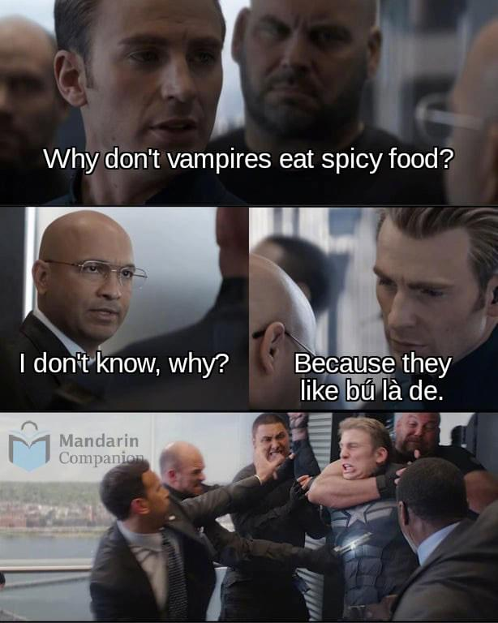
Meme Time!

Slide 15
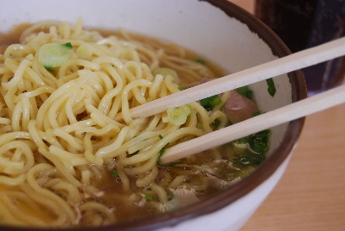
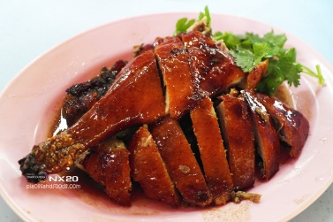
Ordering (Part 4)
Food Phrases for Placing Your Order in Chinese
yī wǎn (一碗) — One bowl of
yī pán (一盘) — One plate of
yī fèn (一份) — One serving of
Zhà (炸) — Fried
Chǎo (炒) — Stir-fried
Zhǔ (煮) — Boiled
Kǎo (烤) — Roasted
fàn (饭) — rice
chǎo fàn (炒饭) — fried rice
miàn (面) — noodles
chǎo miàn (炒面) — (stir) fried noodles
tāng miàn (汤面) – noodle soup
cōng (葱) — green onions
Běijīng kǎo yā (北京烤鸭) — Peking duck/Beijing Roast Duck

Slide 16
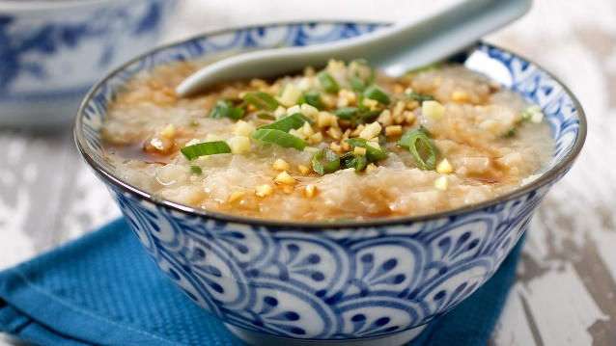
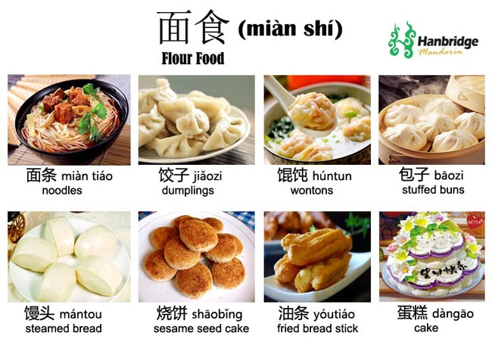
Ordering (Part 5)
Below is a list of other popular foods that you might order:
zhōu (粥) Congee
qīng cài (青菜) Leafy greens/Vegetables
jiǎo zi (饺子) Dumplings
miàn (面) Noodles
dòu fu (豆腐) Tofu
bāo zi (包子) Stuffed buns

Slide 17
Meme Time!
zhōu

Slide 18
Other Food Items? (Requests from You)

Slide 19
During the Meal
WHAT YOU MIGHT SAY
Qǐng jiā chá (请加茶!) “Please add tea!"
“Wǒ yào…” (我要…) I want/would like…
“Zhè bú shì wǒ diǎn de.” (这不是我点的｡) This is not what I ordered.
NEW VOCABULARY
jiā (加) – verb – to add
cān jīn (餐巾) – noun – napkins
dān (单) – noun – bill
UTENSILS
kuài zi (筷子)– noun – chopsticks
chā zi (叉子)– noun – fork
shǎo zi (勺子)– noun – spoon
dāo zi (刀子 )– noun – knife

Slide 20
After the Meal
WHAT YOU MIGHT SAY
“Qǐng mǎi dān.” (请买单｡) Please bring the bill.
“Duō shǎo qián?” (多少钱?) How much is it?
“Wǒ de dān bù duì.” (我的单不对｡) My bill is incorrect.
“Wǒ kě yǐ shuā kǎ ma?” (我可以刷卡吗?) Can I use a credit card?

Slide 21
On Tipping (xiǎo fèi)
It’s not customary to tip in restaurants in China.
If the service was exceptionally good, and you are paying in cash, you can simply tell them that the remainder is tip.
“Zhè shì xiǎofèi (这是小费｡)” “This is the tip."

Slide 22
Finished?
Hěn hào chī! (很好吃!)
Very good!/Tasty
Xiè xiè! (谢谢!) Thank you!
Zài jiàn! (再见!) Goodbye!

Slide 23
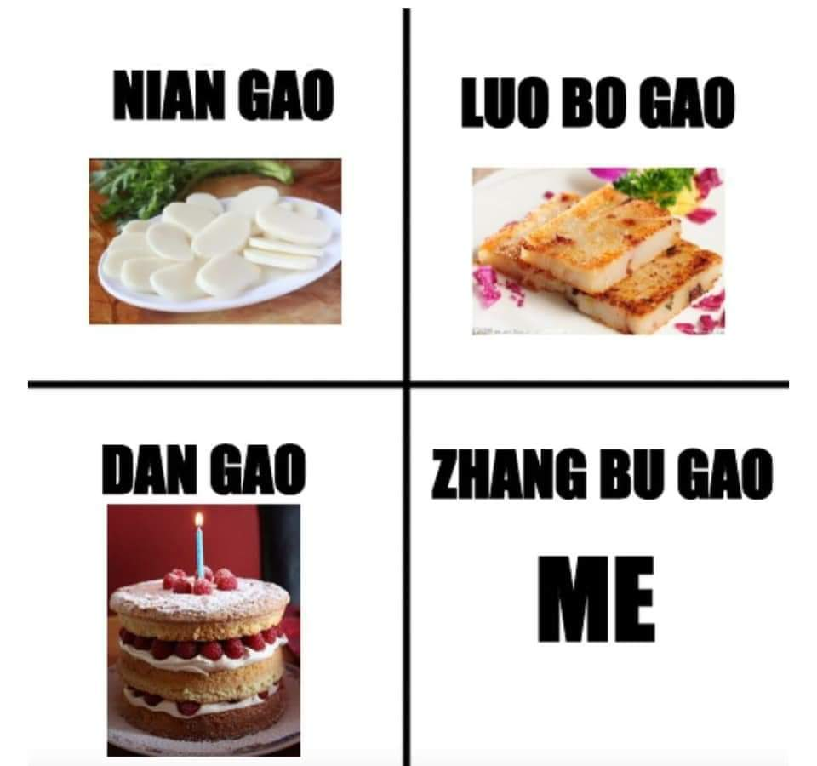
Meme Time!

