Slide 1
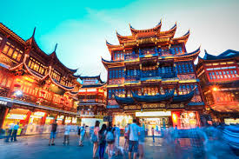
INTRO TO PINYIN AND TONES

Slide 2
#1 What is pīnyīn?
Pīnyīn is the romanization of characters that helps foreigners to learn chinese. For example:
我 = wǒ = I/me
character pīnyīn English

Slide 3
Why do we need pīnyīn??
- Pīnyīn will help us know how the characters sound (since we can’t sound out words like we do in English).
-We will learn more about pīnyīn as we start to learn new Chinese vocabulary.

Slide 4
Examples of “pīnyīn”
我 他
你
學
= wǒ
= tā
= nǐ
= xué

Slide 5
Consonant Sounds
Consonants | Sound | Pronunciation | English Sound Examples | Pīnyīn Example
 | c | ts | “its” | cóng (from)
 | q | ch | “cheese” | qù (go)
 | un | une | “June” | yún (cloud)
 | x | sh | “sheep” | xiǎng (think)
 | z | dz | “woods” | zuò (sit)
 | zh | dge | “fudge” | zhù (live)
The “v” and “th” sounds don’t exist in the Chinese language.

Slide 6
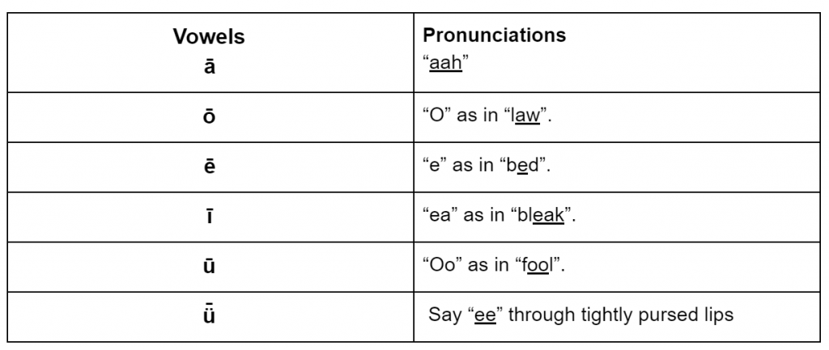
Vowel Sounds
When the “e” is at the end of a word, it makes the “uh” sound – like “cup”

Slide 7
Let’s Practice
wǒ
nǐ
tā
mén
zhè
nà
líng
8. èr
9. lǐ
10. me
11. de
12. le
13. qī
14. jiǔ

Slide 8
Vowel Combinations
Vowel Combinations | Sound | Pronunciation | English Sound Examples | Pīnyīn Example
 | ai | ie | “eye” | mǎi (buy)
 | ao | ow | “cow” | gāo (tall)
 | ei | ay | “hay” | lèi (tired)
 | ia | ya | “yarn” | xià (down)
 | ou | ow | “flow” | gǒu (dog)
 | ie | ye | “yeah” | xiě (write)
 | ui | way | “way” | shuǐ (water)

Slide 9
Let’s Practice
pāi
māo
měi
jiā
tóu
jiě
duì
8. nǎo
9. diàn
10. zhǐ
11. chuáng
12. cuò
13. cè suǒ
14. xǐ shǒu

Slide 10
Which one???
pai pei pi pie

Slide 11
Which one???
hai hei hi hey

Slide 12
Which one???
hong heng hang

Slide 13
Which one???
chang zhang
cheng chong

Slide 14
#2 What are tones?!
-Unlike English, Chinese is a “tonal” language, which sometimes makes it scary for English speakers to want to learn.
-However, once you get the tones, the language is easier to learn than English.
-The Chinese language has 4 different tones.
-Though tones are very important, still is possible to determine what you are trying to say based on context.

Slide 15
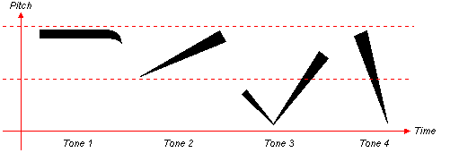
“Flat tone”
“Rising tone”
“Question tone”
“Falling-rising tone”
“Checkmark” tone
“Falling tone”
“Exclamation tone”

Slide 16
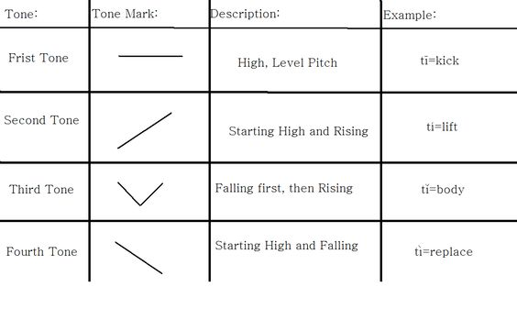

Slide 17
Comparing Chinese tones to English words:
Tone 1: Man, oh man is it hot! Oh, man.
Tone 2: What did you see, man? Hey, man!
Tone 3: Come on, man, you can do it!
Tone 4: Man! That's hot!
Tone 5: Common.

Slide 18
Sometimes…
-Even though a lot of times, you can determine the meaning without the exact tones…
-If you say the right pronunciation but with the wrong tone, you could be saying something completely different…..
….. for example….

Slide 19
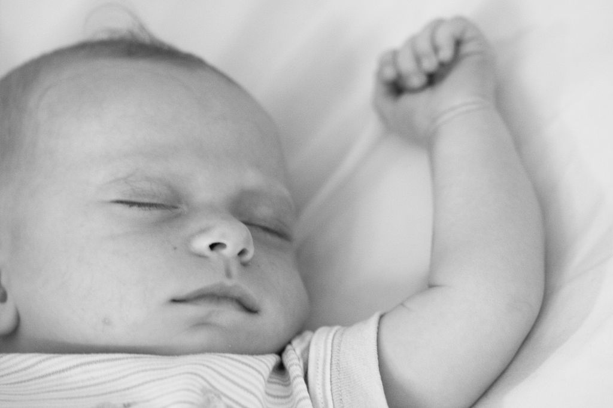
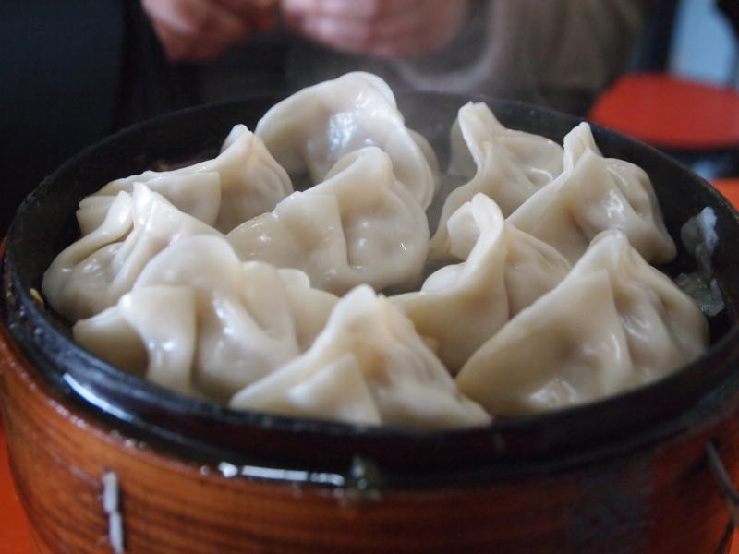
shuìjiào = to sleep
shuǐjiǎo = dumpling

Slide 20
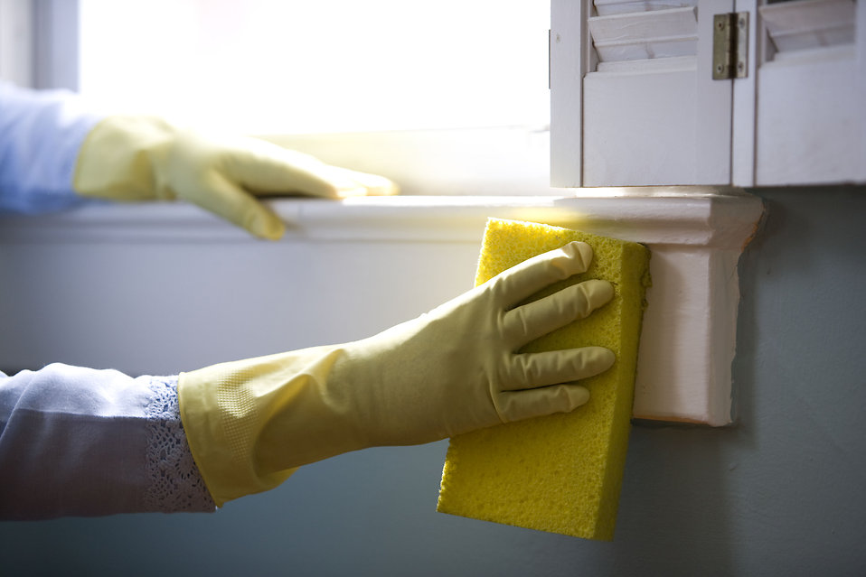
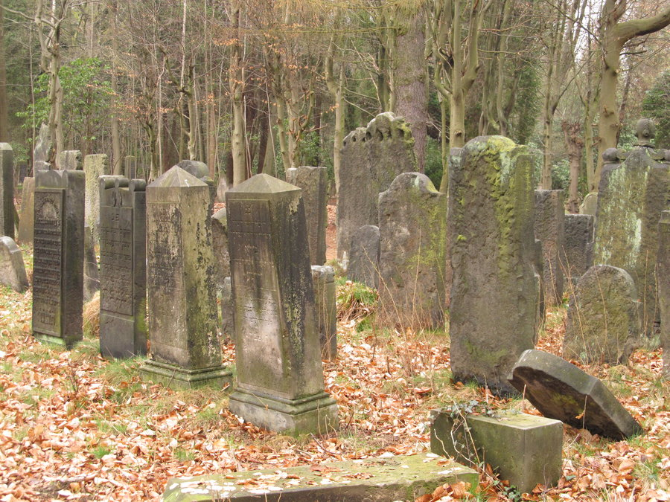
shōushi = pick up/clean up
shōushī = bury the dead

Slide 21
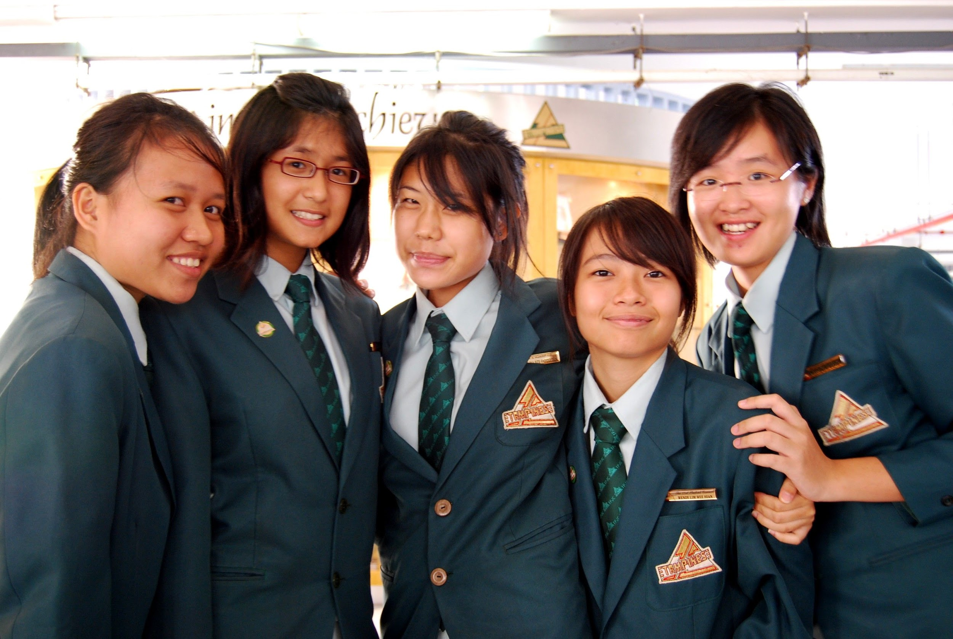
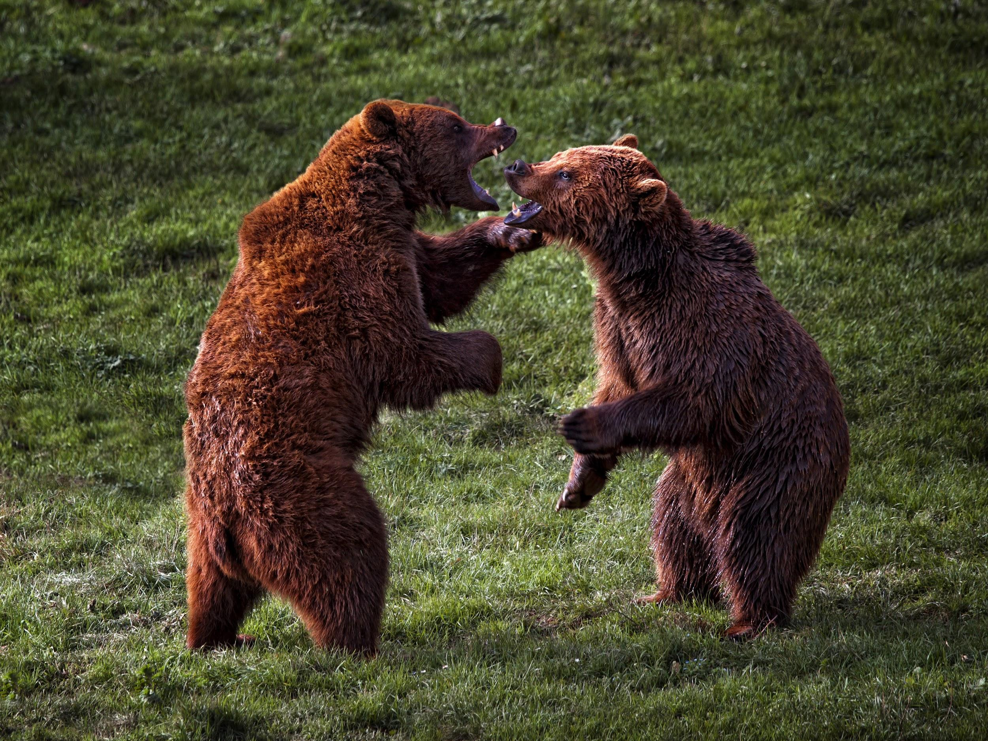
dàjiāhǎo!= Hey everyone!
dǎjiàhǎo = fighting is good

Slide 22
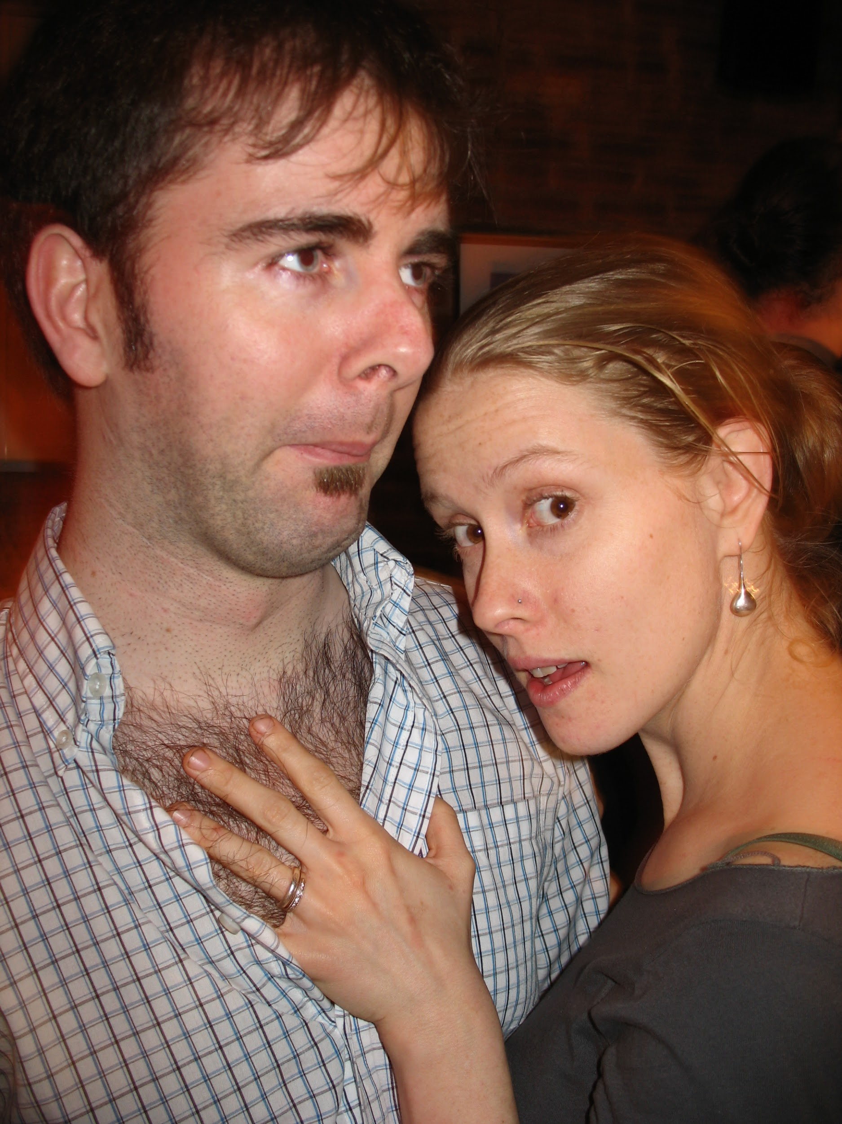
xióngmāo= panda
xiōngmáo = hairy chest

Slide 23
Practice, practice, practice
bā bá bǎ bà 2) mā má mǎ mà
3) nī ní nǐ nì 4) wō wó wǒ wò
5) lā lá lǎ là 6) hē hé hě hè

Slide 24
More practice…..
xuē xué xuě xuè 2) lāo láo lǎo lào
3) hēn hén hěn hèn 4) xiōng xióng xiǒng xiòng
5) jiāng jiáng jiǎng jiàng
6) chāng cháng chǎng chàng

Slide 25
Practice Identify Tones
I will say a number 0-10, you hold up your fingers to indicate 1st, 2nd, 3rd or 4th tone.

Slide 26
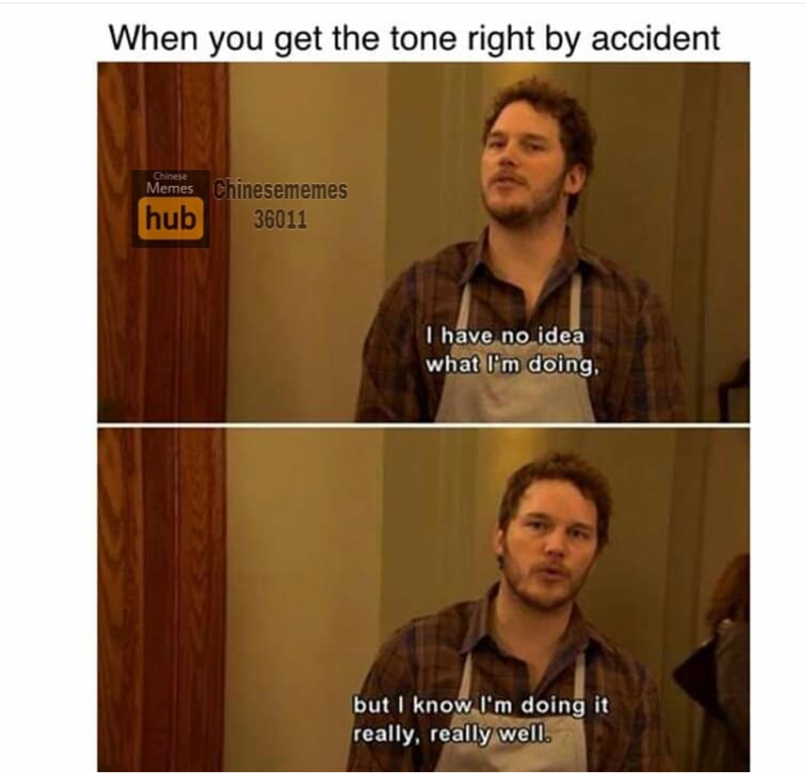
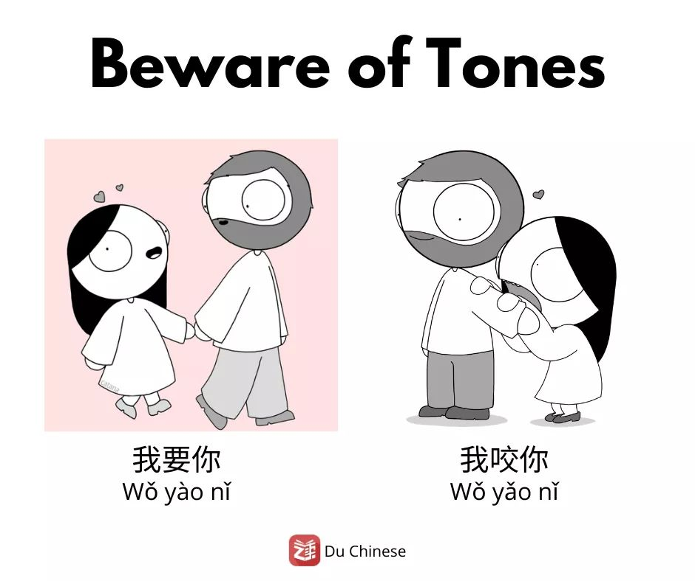

Slide 27
Tones Whiteboard Race
The class will be divided into teams.
I will say a word, and everyone will write on their whiteboard which tone they think they hear.
As soon as the ENTIRE TEAM has their hands up, I will check to see if they are correct. If everyone has the right tone, they win a point. If not, I move to the next team that’s ready.
The winning team will be awarded HOUSE POINTS

