Slide 1
pronouns
By: 高老师 (Mrs. Roquemore)

Slide 2
What are Pronouns?
Pronouns = A word that substitutes as a noun/noun phrase
English examples:
He/him
She/her
They/them
It
I/me
You
We/us
This
That
Pronouns are also usually the subject of a sentence
A subject = who/what a sentence is about

Slide 3
Common Singular Chinese Pronouns
I/me = wǒ (我)
You = nǐ (你)
He/him = tā (他)
She/her = tā (她)
It = tā (它)
This = zhè (这)
That = nà (那)

Slide 4
How to Make These Pronouns Plural
I/me →
You →
He/Him →
She/Her →
It →
This →
That →
Us/We
You guys, You all, Y’all
They/them
They/them
They/them
These
Those

Slide 5
How to Make Common Singular Nouns Plural
When talking about people, the way to “pluralize” a pronoun is to add the word “mén (们)” to the end of it.
(Sometimes it is written with a 2nd tone: mén)
I/me (我) = wǒ
We/Us = wǒ mén (我们)
You (你) = nǐ
You guys/y’all/you all = nǐ mén (你们)
He/him (他) = tā
They/them = tā mén (他们)
Can also include a group with males and females
She/her (她) = tā
They/them = tā mén (她们)
If used with this character 她, it is a group of only females.
It (它) = tā
Them/they = tā mén (它们)
Used when talking about a group of non-human objects (animals)

Slide 6
How to Make Common Singular Nouns Plural (Continued)
For objects/things, the way to “pluralize” a pronoun is to add the word “xiē (些)” to the end of it.
This (这) = zhè
zhè xiē = these (这些)
That (那) = nà
nà xiē = those (那些)

Slide 7
Pronoun Possessives

Slide 8
Pronoun Possessives
In English, we use possessives to show that something belongs to someone.
Common ways to show possession:
’s
My/mine
Your/yours
Y’all’s, you guys’s, you all’s
His
Hers
Its
Their/theirs

Slide 9
Singular Pronoun Possessives
In Mandarin Chinese, we use the word “de (的)” to show that something belongs to someone or something.
I/me = wǒ (我)
My/mine = wǒ de (我的)
You = nǐ (你)
Your/yours = nǐ de (你的)
He/him = tā (他)
His = tā de (他的)
She/her = tā (她)
Hers = tā de (她的)
It = tā (它)
Its = tā de (它的)
zhè and nà do not have possessives

Slide 10
Plural Pronoun Possessives
In Mandarin Chinese, we use the word “de (的)” to show that something belongs to someone or something.
我们的 - wǒ men de
Our/ours
你们的 - nǐ men de
Your/yours/y’all’s/you all’s/you guys’ (group)
他们的 - tā men de
Their/theirs (includes all males or males & females)
她们的 - tā men de
Their/theirs (all females)
它们的 - tā men de
Their/theirs (animals)

Slide 11
review

Slide 12
Review New Vocabulary
“mén (们)” = turns a person into a “group” of people that they’re part of
“xiē (些)” = turns the words “this/zhè (这)” & “that/nà (那)” into multiples
“de (的)” = shows possession

Slide 13
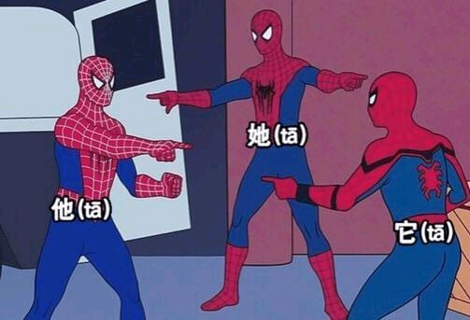
Practice
me/I
Our/ours
They
You all, you guys, y’all
They, them (female)
Your/Yours
His
It (animals, objects)
These
She/her
You
My/mine
13. Those
14. This
15. Them/they (animals)
16. He/him
17. That
18. We/us
19. You all’s, you guys, y’all, your/yours (group)
20. Its
21. Theirs
22. Hers

Slide 14
Practice
 | Make it Possessive | Make it Plural | Make the Plural Possessive
I/me
You
He/She/It
This
That

